Slide 1
Learner guide BUSINESS SKILLS Identify potential hazards in the workplace
UNIT STANDARD NUMBER : 110064
LEVEL ON THE NQF : 2
CREDITS : 2

Slide 2

PURPOSE:
This Unit Standard is intended for all people who are involved in, or who intend to be involved in administration in commercial and/or non-commercial organisations. Competence against this standard will add value to the learner`s job, or chances of finding employment. The qualifying learner is capable of:
Demonstrating an understanding of standards and procedures governing health, safety and security in the workplace.
Contributing to a safe and secure work environment.

Slide 3
SESSION 1. Identify potential hazards in the workplace
Potential hazards are correctly identified and removed, reduced or reported in terms of own level of authority/capacity.
Instructions relating to exposure to dangerous substances and hazards in the workplace are known and an explanation is given as to why they pose a potential threat to the work environment.
The kinds of work that require protective clothing are identified and protective clothing is used according to legal requirements.
Health and safety instructions are followed in situations that require lifting and handling of materials.
The importance of each employee being vigilant and reporting hazards and violations of health, safety and security procedures is known and understood with reference to a possible chain of events that could result from not reporting a violation.

Slide 4
Introduction
The Need for Safety, Health and Environmental Protection
Early Days
Since the existence of man, he has used natural objects as tools to assist him in performing tasks he alone was not capable of doing e.g. a stone to crush a hard seed or a branch of a tree to dislodge a large rock. This practice allowed man to do much more in a much shorter period of time.
At the same time, however, man also discovered that working with these tools could cause injury and even death. Some practices caused disease due to the material that was handled or the environment where the work was undertaken. In his book “River God”, Wilbur Smith describes the activities of sculptors working inside a burial tomb. Many of them died as result of the clogging of their lungs, due to dust inhalation. This phenomenon was attributed to the intervention of the gods, as it could not be understood or explained.

Slide 5
Being the resourceful being he is, man quickly learned how to minimise or avoid injury and fatalities by devising methods for using tools more safely under safer conditions. This can be seen as the beginning of basic health- and safety management.
The invention of the wheel made man mobile and new tools and operating procedures were developed to cope with the demand created by new inventions and the use thereof.
For centuries man slowly developed new tools and machines, enabling him to achieve even more than what was ever possible. In the process he used existing tools to make and develop new ones.
Certain trades were established and standards were set to promote uniformity.
Safe practices became standard practices.
In society the introduction of innovations such as running water on tap and (for the time) hygienic ablution facilities contributed substantially to the health and prosperity of man in general.

Slide 6
Accidents in The Workplace
An Accident is an undesired event caused by unsafe acts or unsafe conditions that cause physical harm or has the potential for harm or the potential for loss.
Causes of Accidents
The three contributing factors that result in accidents are as follows.
Unsafe acts 88%
Unsafe conditions 10%
Acts of providence 2%
98 % of all accidents can be prevented due to the causes of these accidents are things people do wrong in the work place.
2 000 000 Accidents were investigated and it was found that for every one major accident that caused death or disablement there can be 10 accidents that only caused minor injuries where only First Aid treatment was required, and 30 accidents that caused property damage.

Slide 7
Identify Potential Hazards
There are various substances in the workplace which could harm the physical and possibly the mental health of workers. For example, toxic waste can be just as deadly as an unguarded machine mechanism, or over-exposure to poisonous gases or radiation can kill just as surely as a treacherous fall.
The types of hazards which could be detrimental to the health of workers are mentioned in this lesson. These health hazards can be combated or reduced by wearing appropriate protective clothing and/or equipment. Some protective clothing is washable and can be re-worn, while other clothing is disposable. It is even possible to apply protective ointments and creams (barrier creams) to the body, and after the job has been completed, to simply wash off these creams. Workers must realise the importance of their health and safety, and must be diligent in wearing the appropriate protective clothing and/or equipment.
Unsafe acts and conditions also lead to potential hazards in the workplace.

Slide 8
Unsafe acts and conditions
An unsafe act is that which is done, or not done by people, causing injury, disease or damage to property, e.g. operating a dangerous machine or equipment while under the influence of alcohol.
An unsafe condition, on the other hand normally exists where safety procedures have been neglected, e. g. the safety covers of a machine is removed.
We encounter unsafe conditions and unsafe acts every day in our normal lives, even at home.
Driving through an area where hijackings are common, constitute and unsafe act and an unsafe condition. The unsafe condition is the area where hijackings are common, while the unsafe act is to drive through that area. Avoid these areas if you can.
Lighting a cigarette near explosive materials also constitutes an unsafe act and an unsafe condition – the explosive materials are an unsafe condition and lighting the cigarette is an unsafe act.
A river that is in flood is an unsafe condition, while trying to cross the river while it is in flood is an unsafe act.
A heated stove plate is an unsafe condition, while putting your hand on the heated plate is an unsafe act.

Slide 9
Four basic reasons for unsafe
Improper attitudes of the workers;
Lack of knowledge or skills;
Physical unsuitability; and
Improper mechanical or physical environment.
Except for reflex actions, unsafe acts are learnt acts, and can be replaced with learnt safe acts. If an employee's learning has been inadequate or misdirected, it is necessary to retrain an employee in the safe way.
Many employees suffer injury because they are unschooled in safe behaviour, i.e.,
because there is a lack of knowledge of safety rules and procedures,
or a lack of skill in the safe execution of job tasks.

Slide 10
Safe patterns of behaviour must become second nature to employees, so there should be a culture of continual learning in the organisation. This will eventually make safe acts automatic.
Some employees commit unsafe acts to satisfy certain needs, and therefore an employee will try to get away with an unsafe act by using one of his own tricks of the trade. In this case the employee is trying to satisfy an emotional or psychological need. To correct this behaviour will take more than retraining the employee.
When an employee becomes frustrated in the workplace this could result in irrational acts, often of an aggressive nature, which expose other employees to possible injury. Some frustration may also arise from off-the-job conditions, such as domestic circumstances. These frustrations are beyond the supervisor's control, although they too can lead to unsafe acts.
Another cause of unsafe acts is the employee's preoccupation with matters that have nothing to do with his work, for example financial worries can cause undue stress.
To summarise, the causes of unsafe acts could be:
Lack of knowledge and inadequate skills as discussed above
Motivational factors
Difficulties of inattention
Perceptual difficulties

Slide 11
Temporary Periods of Stress
Whatever their ages, all employees are at times subject to temporary periods of unusual stress
If accidents are to be prevented in such periods of tension, it is necessary to assist employees to cope with their times of travail, at least to the extent of providing safeguards and helping with solutions which are within the supervisor's control.
Effect of Personal Problems
Inattention could in many instances be attributed to personal difficulties such as domestic circumstances which cannot be shed by employees as they daily enter the work‑place. It could be helpful if the supervisor became a good listener during these periods, although it is undesirable for the supervisor to become intimately involved with the personal life of the employee. If an employee is enabled to talk out a problem with a sympathetic and understanding listener, he or she could see it in a different and more constructive light.

Slide 12
Effect of Job-related Conditions
Sometimes a number of accident ingredients are present which are beyond the control of the employee. These pre-existing conditions could be hazardous. The employees may be unaware of these hazards, and their reaction to the situation, if they become aware, may be trial-and-error. If their response does not work, emotions may be aroused. The momentarily blind act or emotional act is often an unsafe act. The continuance of adverse job conditions can have an ominous and frustrating influence on employee conduct. This frustration may manifest itself in aggression, rigidity and childishness. These frustrations could also manifest themselves through unsafe acts.
Distractions related to Work‑place Location and Job Monotony
Work‑place locations can lead to unsafe acts if they subject the employee to competing demands, e.g., where workstations are near the toilets or a cafeteria. Monotony can also be troublesome as it often results in self‑induced distractions. Supervisors should be on the lookout for any form of distraction.

Slide 13
Communication the Key to Inattention
The supervisor should communicate meaningfully with the employee.
Sometimes the source of frustration can be rectified by the supervisor.
The supervisor must try to pinpoint the problem clearly. Sometimes the difficulty may have to be resolved jointly by the supervisor and the subordinate. At other times, the problem MUST be resolved unilaterally by either the employee or the supervisor.
Perceptual difficulties
It could happen that the reason for an unsafe act is as a result of perceptual failure. Perception means the ability to see, hear or become aware of something through the senses. It is also a way of understanding something. Perceptual failure means that the worker sees, hears or understands the facts wrongly.
This can happen because the worker has been bombarded with too much information at one time. There are too many signals reaching the worker and this causes a wrong response or a late response. Because of a lack of perception, the worker can react in an uninformed or emotional manner; the worker could also react to a compelling signal without awareness of counter-indications

Slide 14

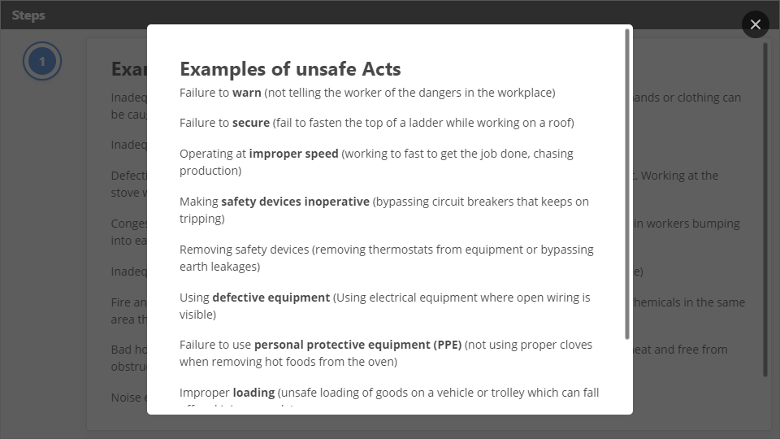
Interaction
Click the Interaction button to edit this object

Slide 15
Types of Hazards Encountered in the Workplace
The OHS Act defines a hazard as “a source of or exposure to danger” and a risk as” the probability that injury or damage will occur.” Each hazard thus has risk(s) involved. If you don’t disconnect the electricity supply before working on an electrical appliance you run the risk of being electrocuted.
The degree of risk involved varies according to the situation. When using a sharp knife to peel an apple, a two-year-old toddler will run a much greater risk of cutting himself than an adult performing the same exercise.
Safe, according to the OHS Act means “free from any hazard”.
Hazards will differ from work place to work place, and they could be the following, depending on the circumstances.
For better understanding we will group hazards as follows:
Physical Hazards
These hazards can harm the body and/or influence or stop the effective functioning thereof.

Slide 16

Interaction
Click the Interaction button to edit this object

Slide 17
Ergonomic Hazards
These hazards relate to how “worker friendly” the worker’s working environment is. Working under unfavorable conditions can cause discomfort and injury. Factors like having to stand for long periods, working in cramped spaces, not having adequate ventilation, etc. can all cause discomfort and eventual injury. The hazard is present in the working condition and the risk is the injury that could happen as a result of the hazard.
Illumination
Illumination is also an ergonomic hazard. For example, employers should attend to burnt out globes; defective fluorescent tubes; light fixtures covered with dirt, grease, or oil; little or no provision for emergency lighting; unlighted or dimly lit exits;
Temporary lighting that has become permanent through oversight; and poorly-placed lighting sources that cast shadows in the employee's work areas.

Slide 18
Psychosocial Hazards
This normally goes hand in hand with stress and tension in the workplace. A disgruntled worker might be so upset that it affects his ability to concentrate properly. If he works with dangerous machinery or equipment his lack of concentration may cause him to overlook safety precautions, resulting in injury or damage to property. working with machinery is hazardous and the risk is injury or damage to property if the machine is not operated safely.
Hazardous substances
"Substance" includes any solid, liquid, vapor, gas or aerosol, or combination thereof.
Examples are
inorganic materials such as lead, mercury, arsenic, cadmium, and asbestos
and organic substances such as polychlorinated biphenyls (PCBs), vinyl chloride, and the pesticide DDT, benzene

Slide 19

Protective Clothing
Personal Protective Equipment or PPE is the primary control measure to personal safety. When using Personal Protective Equipment, the hazards are still present in the environment. The protective device merely provides a barrier between the hazard and the worker.
It is imperative to understand that the issuing of Personal Protective Equipment is the last resort when all other methods fail to render the hazard safe.
The personal protective equipment supplied to you by your employer is for your personal safety and should be used by you only. This PPE remains the property of the COMPANY and should you misuse or abuse any safety equipment, action will be taken against you.
It is the responsibility of the workers to look after the safety equipment provided and to use it where required to by safety signs, and management ruling. It is your responsibility to report any defects of your safety equipment to your supervisor immediately.
When entering the client’s premises, boards indicating the required PPE/PPC are displayed to inform people entering the site what to wear.

Slide 20
Reasons why protective equipment and clothing is not worn
The equipment cannot be worn comfortably and with ease.
The protective equipment interferes with normal working procedures.
The worker does not understand (ignorant) the necessity of wearing the equipment and clothing;
There has not been proper training and induction of the worker to his work environment.
The worker is not penalised or disciplined for not wearing the equipment.

Slide 21
Requirements for protective clothing and equipment
As far as personal protective clothing and equipment are concerned, the worker must be able to wear the equipment with ease and comfort; the protective clothing or equipment must not interfere with his normal working procedures; the necessity for wearing protective clothing/equipment must be brought home to the worker; and economic and other disciplinary action must be used to coerce the worker to constantly use protective clothing and equipment.
The problem encountered with protective clothing and equipment is the fact that‑ these measures do not' eradicate the danger out of mechanical hazards of machinery ‑ these hazards have to be designed out of machinery; the correct choice of equipment is not always easy; and getting workers accustomed to protective gear is sometimes difficult.

Slide 22

Types of physical protective equipment available
Besides respirators and masks to filter out dust and fumes, and goggles and shields to guard the eyes, the following protective equipment is available:
Protective hard hats/caps and women's nets;
Aprons, Suits and jackets;
Ear muffs;
Visors and face shields;
Welding helmets;
Boiler suits;
Dust-coats;

Slide 23
Protective garments can be made of plastic, leather, asbestos, artificial fibres and so forth, depending on what type of protection is desired.
The aim of using protective clothing and equipment is to protect the human body and all its senses, e.g., hearing, seeing and smelling, from harm. Workers who do not wear goggles or ear muffs could lose their sight or sense of hearing.
Workers should also be protected from the stealthy killers such as asbestos dust, imperceptible gases, e.g. LPG or liquefied petroleum gases, and mercury poisoning. Gases and other harmful substances should be correctly stored in properly marked containers. Employers should always monitor the levels of poisonous gases and other dangerous substances in their factories.
Because every injury on duty has financial implications for both the employer and the employee, it is essential that injuries should be reduced to the absolute minimum.
Workmen who are injured on duty can claim for compensation in terms of the WORKMEN'S COMPENSATION ACT, 1941 (Act 30 of 1941). No compensation is paid if the workman is guilty of serious and willful misconduct, unless the accident causes serious disablement or the workman dies. If the accident leads to serious disablement or death, the Commissioner will pay compensation even if the workman contravened the law or his employer's instructions, or acted without instructions, but only if he was injured while engaged in his employer's business. Should the workman be killed, his dependents are entitled to compensation.

Slide 24

Head Protection
Hard hats provide protection for the head in areas where the danger of falling or flying objects exists, or where the head could be bumped against low structures.
However, this protection could also be lost when a hard hat is cracked or the insert is damaged or missing. Hard hats must never be used as a seat or a bucket or for any other purpose except that for which they were designed. Hardhat linings must be washed when dirty and at least on a monthly basis

Slide 25
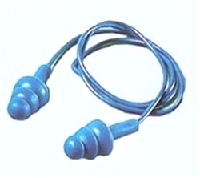
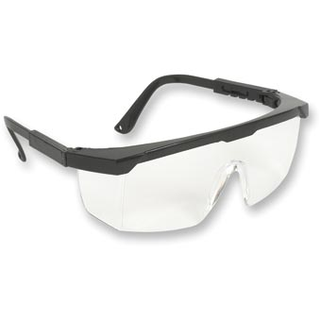
Hearing Protection
Earplugs and earmuffs provide protection for the ears in noisy, hazardous areas, to prevent loss of hearing. Ear protectors must be maintained in an efficient and sanitary condition at all times. They should be stored in clean, dust-free containers; otherwise, users could suffer from infection of the ears.
Eye and Face Protection
Different situations will require different safety equipment. It is important that the most effective eye protection be worn and that the care must be taken when storing and cleaning this safety equipment as the lenses can scratch and thus causing a reduction in sight. Store this equipment in such a way that the lenses will not scratch.
Safety spectacles provide protection for the eyes and must be worn where the danger of flying particles exists, e.g. where metal hand tools are used, such as chisels.

Slide 26
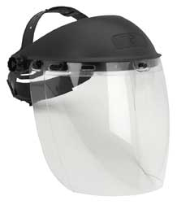
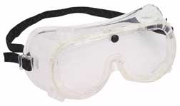
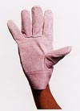
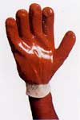
Full-face shields must be worn when grinding work is done, and where splashing hazards exist.
Safety goggles must be worn in all dusty areas. All employees involved in flame cutting, welding or brazing operations must wear welding goggles.
Hand Protection
Safety gloves provide protection for the hands and must be worn if there is a chance that employees could suffer injuries to the hands, e.g. cuts or severe abrasions. Safety gloves must be kept clean and in a good condition and must never be neglected and left to lie around haphazardly.

Slide 27
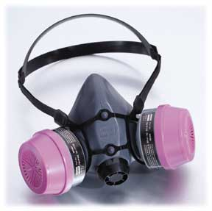
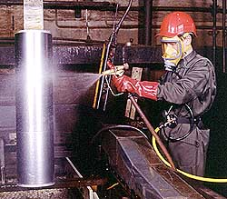
Breathing Protection
There are two kinds of protection available
Filter type
These respirators have filters, cartridges, or canisters that remove contaminants from the air by passing the ambient air through the air-purifying element before it reaches the user. These filters have a limited life span an have to be replace at regular intervals.

Slide 28
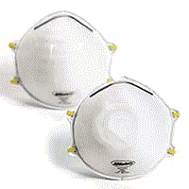
Air supplied type
These supply clean air directly to the user from a source other than the air surrounding the user. The clean air is supplied by means of an “air hose” and this hose will have to be attached to the worker. Care must be taken as not to damage the “air hose”.
Some of these filter type respirators can only be worn once or have a limited effective lifetime, and are to be changed when the user feel that little protection is offered.
Respirators must be stored in such a manner that they will not be damaged and exposed to any substance. It is important to clean and inspect the respirator after it has been used.
Before using a respirator, make sure that the respirator will offer the required protection and that all the parts are in a good working condition

Slide 29
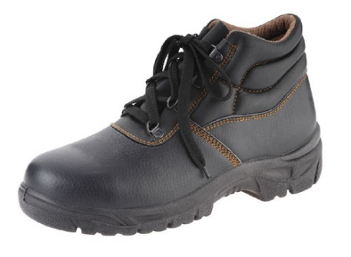
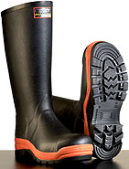
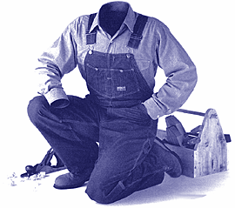
Foot Protection
Safety shoes are fitted with steel toecaps and provide protection to the feet against falling objects. Safety shoes and lasses must be kept in a good condition (cleaned and polished regularly) and must never be neglected.
Protective Clothing
Overalls are issued to employees to reduce the possibility of injury caused by contact or radiated heat, cold, abrasive or sharp surfaces. Loose, tattered clothing worn by employees is not only indicative of an untidy method of working, but is also a hazard as it is likely to get caught in moving machine parts.

Slide 30
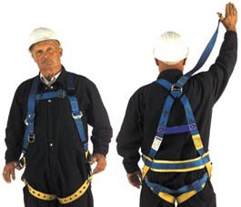
Safety Harness
Safety belts, harness, lifelines, and climbing shoes are essential to protect employees carrying out hazardous work above ground level. These items must be kept in an excellent state of repair and maintenance must be done under strict supervision. This equipment must be stored as per the equipment manufacturer’s instructions.
Important information about PPE
Wear your personal protective equipment and clothing, you have everything to gain!
Remember that these items are expensive and in order to gain maximum protection from them, one must treat them with respect.
The PPE will only be effective if it is used correctly and for the purpose that it was designed for.
You must report defective equipment of ineffective PPE to your supervisor or Health and Safety Representative immediately. Using damaged or ineffective PPE will damage your health and will lead to other injuries

Slide 31
Prevent accidents through proper housekeeping
Proper place for everything
In the plant or factory, it is essential that everything has its proper place, i.e., the factory must be orderly and tidy so that there is no need to search for tools; so that space is saved; so that fire hazards are reduced; and so that injuries are avoided. If there is poor housekeeping, the incidence of accidents is bound to increase, e.g., tripping over loose objects; articles dropping from above or on a worker's head; slipping on greasy and dirty floors; staff running into protruding materials and objects; hands and other bodily parts being injured on projecting items such as nails; and fires.

Slide 32
Definition of housekeeping: A place for everything and everything in its place.
Good lighting.
Good ventilation
Hygiene facilities to be kept clean
All aisles and storage areas clearly marked
Good stacking and storage practices
Stacked goods must not endanger life
Factory yards must be kept tidy
All refuse to be placed in bins

Slide 33
Remember the definition of housekeeping; the following steps should be practiced in the housekeeping concept.
Passages, aisles and walkways should be marked and kept clear of obstacles to prevent workers and visitors from injuries.
Waste bins should be provided. If there is no waste bins workers tend to through waste materials and papers on the floor, this will create a fire hazard in the work place.
All spillages must be cleared and cleaned immediately to prevent workers to slip, or be contaminated if chemicals are involved.
Report any unusual parcels or packages to security
Place everything in the correct place and store all products correctly.
Clean up your work place at the end of every shift. (Do not leave it for the follow-up shift to clean.

Slide 34
Benefits of good housekeeping
The effect of good housekeeping on staff is that it improves both the working environment and morale of the workforce. This means more pleasant working conditions which will in the long-term increase efficiency, ineffectiveness and economy.
The main benefits of good housekeeping are as follows:
Reduced operating costs
Improved production control
Production time is saved;
Traffic flow is facilitated;
There is higher employee morale
Increased production materials and parts are conserved

Slide 35
How to Work Safely
In order to help you with inspections and also to be able to develop an inspection check list, we will take a look at what has to be done in order to work safely.
Never:
Enter a work area that you have not been authorised to enter.
Operate any equipment that you have not been trained to operate
Always Wear:
suitable protective clothing
safety boots
hard hats
overalls

Slide 36
Use Gloves, Aprons Other Special Clothing When Handling:
rough materials
chemicals
hot or cold objects.
Wear hearing protection whenever notices indicate that you are in an area that requires you to wear hearing protection.
Wear Respirators When:
spray painting
welding and cutting
the area is very dusty
there is any other toxic danger
in other areas where it is required

Slide 37
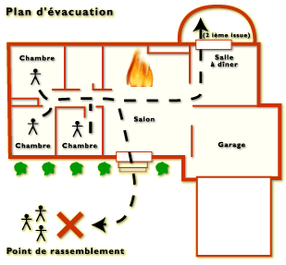
Get To Know Your Work Place, In Particular:
warning and prohibitor signs
location of firefighting appliances
your safety representative and first-aider
emergency exits.
Be Aware Of Other Work Near You.
In particular:
do not walk under suspended loads and be aware of persons working above you
watch out for vehicles
mobile equipment.

Slide 38
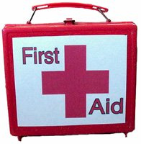
First Aid & Occupational Hygiene
Every workplace, however small, is equipped with a First Aid Box. First Aid Boxes will be allocated to certified first-aiders. Every injury must be treated and reported to the person in charge. Injuries, which require professional medical treatment, an appropriate accident report form has to be made out immediately by the person in charge and the injured person taken to the site clinic.
First Aid Boxes must be kept properly stocked with the minimum required contents.
or when the room in which they are installed is unoccupied.
Manholes
Work in manholes is governed by rules of work conducted in confined spaces.
Dangerous Places
All open holes, as well as open sides of buildings must be made safe by respectively boarding over and / or by barricading to prevent people from falling to another level.
Barricading
All minor and excavations must be barricaded by means of solid barricading.
Barrier (chevron) tape will be allowed as a means of demarcation only.

Slide 39
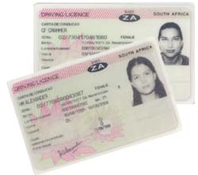
Motor Vehicles
Only authorized persons may drive Company vehicles.
The driver must have the appropriate license for the vehicle he is driving.
If involved in any accident onsite / off site resulting into damages to the vehicle, the Responsible Person must be notified and required accident report form completed.
Transporting Personnel / Material
No person is allowed to be transported on the loading platform of a truck or LDV unless the following conditions are met:
The driver of any vehicle must ensure that before reversing his vehicle there are no people in his path or if so, they are aware of his vehicle’s movements at all times.
All construction vehicles, and mobile equipment shall be fitted with a reverse alarm/hooter.

Slide 40
Special precautions
Special care must be taken with substances such as liquids and chemicals, and also with tools and equipment, particularly explosive powered tools.
Guidance should be sought from the manufacturers about the handling of hazards associated with the storage of oils, reagents, acids, flammable and toxic substances. The three commonly used mineral acids; nitric, hydrochloric and Sulphur are explosive under certain circumstances and require careful handling and storage.
Powerful oxidizing agents such as chlorates, nitrates and peroxides can also become explosive when they are mixed or come into contact with organic matter such as starch, gum and resin.
Sodium peroxide will heat up in the presence of moisture, and all of these substances will release oxygen if sufficiently heated, thus enhancing the danger of fire.
Racks and holders suited to the size of tools and equipment should be provided.
Explosive powered tools and cartridges must be stored in a safe place to ensure that they are inaccessible to unauthorised persons.

Slide 41
Other precautionary measures
Colour Coding for Safety Identification
It is usual practice in the factory setup to colour code some hazardous areas, machinery or dangerous substances, e.g.
the colour RED usually indicates danger; fire protection equipment or stop buttons and emergency stop controls;
YELLOW usually indicates caution; and warnings of hazards from radio‑activity;
GREEN indicates the location of first aid facilities; location of gas masks; exit signs other than emergency signs; safe areas; parking areas; equipment storage; safety instruction; toilets; offices and entrances;
light ORANGE is used on the inside surfaces of machine guards as well as the dangerous parts of a machine capable of cutting, shearing or crushing; the surfaces of protruding shafts, the faces of gear wheels and any rotating part of a machine.

Slide 42
Factory Layout
It is essential that the factory layout and premises in general are maintained in a good condition. This will minimize the risk of accidents.
Faulty design or maintenance of premises, obstruction of access routes and traffic aisles should be prevented.
Floors should not be overcrowded/overloaded.
Floor and wall openings, staircase wells, passenger and goods lift cages, gangways and overhead platforms should all be suitably fenced.
Guard rails should be of adequate dimensions and strength, and toe-boards should be fitted on gangways passing over areas where people are working and where there is a danger of falling objects.
Suitable means of access to machinery and equipment should be provided so that maintenance teams are not required to perform dangerous or acrobatic maneuvers in their regular work.
Crush, nip or shear points between moving and stationary objects should be eliminated or guarded.
Emergency exits to ensure a means of escape in the event of fire should be sufficient in number, correctly positioned and signposted, and free from encumbrance.
Good lighting is essential for the safe movement of persons, plant and equipment. Inadequate lighting levels may conceal obstacles or danger zones, whereas badly positioned or excessively powerful light sources nay cause glare.

Slide 43
Classes and types of machine guards
There are two classes of machine guards, namely, transmission guards and point of operation guards.
There are three types of guards, namely:
Fixed Guards ‑ these do not move with each operation;
Interlocking Guards ‑ these guards prevent the controls of the machine from being used until the guard is moved into place; and
Automatic Guards ‑ these prevent the machine operator from coming into contact with the dangerous parts of a machine while it is moving.
Requirements of machine guards
Machine guards should comply with the following requirements:
They should afford the maximum protection possible;
The danger zone(s) should be blocked out during operation;

Slide 44
Moving machinery
Maintenance and adjustments should never be carried out on machinery that is running or moving.
Machinery must be stopped and "locked out" before any repair or maintenance work is carried out. "Locked Out" means that any electricity, steam, air pressure or anything else that drives the machine is disconnected or isolated so that the machine being worked upon, cannot be accidentally started and so injure the person carrying out the work.
Maintenance of mechanical equipment
Mechanical equipment must be maintained and kept in good order to ensure efficient and smooth operation. Poorly maintained machinery will produce poor quality, place greater strain on the machine, the material and the operator and lead to early failure.
Cutting edges must be kept sharp.
Moving parts must be well lubricated.
Air filters must be kept clean.
Loose parts must be fixed properly with bolts and nuts and not tied with wire

Slide 45
Inspections or repairs on machinery
NO One is allowed to repair, adjust, clean or oil moving machinery unless such is done by a competent person, and only when it is impractical to stop such machinery.
Automatic oiling devices should be installed as far as possi­ble/practicable.
The operator of any machinery must be trained to inspect the machinery that he intends using daily before use.
Company Vehicles
Company vehicles should be checked regularly for
Faulty brakes;
Faulty headlights;
Damaged connecting cables;
General lighting;
Worn tyres;
Faulty windscreen wipers

Slide 46
Fire hazards
Fire hazards exist in processes or operations that use flame producing equipment such as welding and cutting equipment, gas torches and blow lamps.
A few precautions are necessary before and after using this equipment:
Before beginning work, check that there is no combustible (materials that burn easily) materials in the work area.
Clear away any rubbish or litter and make sure timbers (wood) lying nearby and anything else which cannot be removed that might catch fire is protected from heat and flame. This can be done by shielding it with non-flammable material.
Keep a suitable fire extinguisher at hand at all times.
Remember that metal work (such as pipes and conduits) can conduct heat to consumable materials such as floor and ceiling joists.
It is very important to make a further check when the job is done to ensure that nothing has been left smouldering.

Slide 47
Electrical safety measures
Burns from electrical apparatus
Besides electric shock, electricity can also cause external burning, e.g. the arc of a welding machine produces temperatures between 6 0000 to 8 0000 centigrade. Persons standing nearby such an arc will be severely burnt and such an arc may start a fire by igniting flammable material.
When the arc resulting from a breakdown of the insulating material or insulating medium is contained in an enclosure, the heat produced causes the surrounding air or oil to expand rapidly and may also cause an explosion by the expansion of air or oil. Such an explosion can produce extensive damage to property and to persons.
Faulty electrical circuits
Overloading of electrical circuits can produce localised heating of the conductors. The heat so generated may be sufficient to ignite nearby flammable material and thus cause a fire, or alternatively, the heating of the conductors may result in a deterioration of the insulating material and cause a fire.

Slide 48
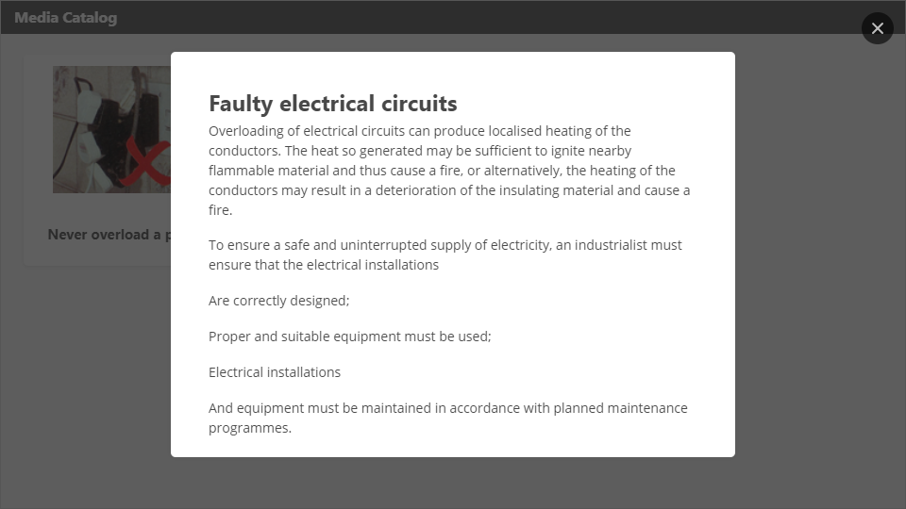
Interaction
Click the Interaction button to edit this object

Slide 49
Other precautionary measures
Colour Coding for Safety Identification
It is usual practice in the factory setup to colour code some hazardous areas, machinery or dangerous substances, e.g.
the colour RED usually indicates danger; fire protection equipment or stop buttons and emergency stop controls;
YELLOW usually indicates caution; and warnings of hazards from radio‑activity;
GREEN indicates the location of first aid facilities; location of gas masks; exit signs other than emergency signs; safe areas; parking areas; equipment storage; safety instruction; toilets; offices and entrances;
light ORANGE is used on the inside surfaces of machine guards as well as the dangerous parts of a machine capable of cutting, shearing or crushing; the surfaces of protruding shafts, the faces of gear wheels and any rotating part of a machine.
Factory Layout
It is essential that the factory layout and premises in general are maintained in a good condition. This will minimize the risk of accidents.

Slide 50
Classes and types of machine guards
There are two classes of machine guards, namely, transmission guards and point of operation guards.
There are three types of guards, namely:
Fixed Guards ‑ these do not move with each operation;
Interlocking Guards ‑ these guards prevent the controls of the machine from being used until the guard is moved into place; and
Automatic Guards ‑ these prevent the machine operator from coming into contact with the dangerous parts of a machine while it is moving.

Slide 51
Suggested materials for machine guards
The preferred material for guards, under most circumstances, is metal. The framework of guards is usually made from structural shapes such as pipe, strapping and bar or rod stock. Filler material generally is expanded metal, perforated metal, solid steel metal or heavy wire mesh. Where visibility is required, guards of formed transparent plastic or of safety glass are widely used. An important factor in the design of a guard is to provide complete protection; the openings must be large enough to admit stock, but small enough to prevent a person or object from getting into the danger zone.
Machine guards for electrical equipment
In addition to safeguarding machinery by mechanical means, the machines which operate by electrical means must be connected correctly, i.e., all machinery which exceeds 42 volts should be connected to an earth-leakage system to prevent electric shock.
An earth-leakage system is so designed that, any leakage to earth on the tool being used will immediately be detected and the flow of current switched off automatically. In some cases, electrical machinery is double insulated to protect the user from electrical shock.
The person installing the machinery must make sure that the machinery has three-core wiring, unless of course it is double insulated.

Slide 52
In other words, the machinery that is not double insulated must have an earth wire which is usually GREEN/YELLOW in colour. Usually the BLUE wire is the neutral wire and the BROWN wire is the live or line wire. The wiring of electrical tools and machinery must be connected correctly.
Portable electrical tools/machinery must be checked regularly for: loose connections; cracked or broken insulations; earth continuity; switches in bad order; and joins in flexible cords. To protect maintenance workers from injury or electric shock from electrical tools and equipment, it may be necessary to place warning notices over machinery to indicate what dangers are latent in the machinery. It may also be necessary to lock the switches to the equipment by padlocks, and only to switch on the equipment where and if necessary. Main switches should be prominently marked.
Moving machinery
Maintenance and adjustments should never be carried out on machinery that is running or moving.
Machinery must be stopped and "locked out" before any repair or maintenance work is carried out. "Locked Out" means that any electricity, steam, air pressure or anything else that drives the machine is disconnected or isolated so that the machine being worked upon, cannot be accidentally started and so injure the person carrying out the work.

Slide 53
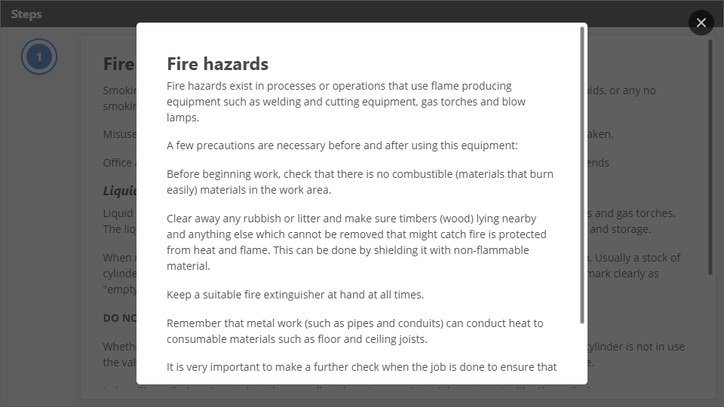
Interaction
Click the Interaction button to edit this object

Slide 54
Flammable liquid store
There may be thinners, adhesives, solvents and paint strippers in the store.
The danger of releasing flammable vapors, with the consequent risk of fire, is greatly increased. Keep this in mind if you visit the store to get a supply of one or other of these substances.
Do not store any other materials such as paper, cardboard, wood, cotton waste etc. together with flammable liquids.
Safety check list for the flammable liquid store
The following rules should be observed:
Check the labels on the containers and make sure you use the correct substance for the job you have to do.
If you have to decant (pour) the liquid into another container, do it outside the store.
Make sure caps and stoppers are replaced on the containers used.
Return containers to their proper place in the store, do not mix them with other containers.

Slide 55
Asbestos
You may come across asbestos in various forms during the course of your work in the building industry and these-are:
Insulating materials used as lagging on pipes:
Low density (soft) asbestos-cement insulation boards used for sound and temperature control.
High density (soft) asbestos-cement roof sheets, ceiling boards, facias, panels and rainwater goods used on factories, warehouses, schools and-residential buildings.
It is important to learn how to use and handle all types of asbestos containing materials (ACM's) safely. The main reason is to prevent the release fine dust from the product.
Breathing of asbestos fibers over a period of time can have a serious effect on your health. Very small fibers (too small for the human eye) can find their way deep into the lungs, where after 10 to 40 years, they can cause the following diseases:
Asbestosis, scarring of the lung tissue, that leaves one breathless, and can lead to lung cancer, or in rare cases:
Mesothelioma, a cancer or the lining or the stomach or lungs.

Slide 56
Hand tools may be used, as they create small chips, which cannot be inhaled.
Standard precautions must be-take when working with asbestos material using high power tools, and these precautions include the following:
All surfaces being worked on must be kept moist.
Always work outdoors, to allow the dust to dilute in the air.
Work away from other and not near any form of intake vents of fans and/or air conditioning units.
If possible, collect all excess dust with an industrial vacuum cleaner, or allow the dust to fall onto moist sawdust, that can be easily cleaned when required.
Do not use a broom to sweep dry asbestos dust.
Always wear a suitable respirator when cutting, drilling or sanding asbestos materials.

Slide 57
Preventing manual handling accidents
All lifting and carrying operations should be supervised.
Personnel should be taught the correct techniques.
Determine how many people would be required to move a load safely BEFORE attempting to move it.
Provide adequate space for the task to be done and point the load in the direction it has to be moved.
Employees should wear personal protective equipment like gloves, boots and aprons.
Where more than one person is required, teamwork is essential.
The supervisor MUST give clear instructions and signals.
Lifting techniques
When lifting and transporting 'a heavy object, such as a box of tiles, or heavy equipment, you should protect yourself from injuries.

Slide 58
Preparing to lift
Before lifting any load ask yourself the following questions:
What has to be moved?
From where and to where must it be moved?
Will assistance be required?
A load which at first seems light enough will become progressively heavier the further you have to carry it. Apart from the risk of strain, it is generally inefficient to carry a load over a long distance. Before lifting and carrying make sure the route is clear of obstacles and the place where the load is to be deposited is not obstructed.
Kinetic method of lifting
The kinetic method of lifting enables you to make full use of your own body weight to initiate the lift. The natural shape of the spine should" remain throughout (although the body may be bent forward the spine should remain straight) and the lift is powered by the strong muscles in the legs and thighs.
"It is important to begin with the right posture; that is, the various parts of the body should be correctly positioned before beginning the lift.

Slide 59
The following points should be noted:
Feet are placed about-5OOmm apart, with one foot slightly forward, in the direction of movement. This gives a 'good balance and 'provides a secure basis for the lift.
Stand CLOSE to the object to be picked up.
Knees should be slightly bent (but not fully bent as in a squat).
Back must be straight, although the body may be inclined forward.
Arms should be as close to the body as possible. The further the arms are extended the greater the strain.
Elbows should be kept in.
Grip must be firm and secure.
Head should be erect with the chin at right angle.
Get a GOOD GRIP on the box/article or equipment to be picked up.
Use the thigh, leg and abdominal muscles to lift, and keep the back straight.

Slide 60
Handling Ladders
There are a number of rules which have to be adhered to whilst handling/ using a ladder:
Avoid bringing a metal ladder near electricity (electrical overhead wires).
Place the ladder so that its feet are a quarter of its own length from the object it is resting against.
Let someone hold the ladder if it is not tied at the top.
Let the ladder extend for a considerable distance above its support' in case it slips down.
Inspect ladders regularly to repair or replace defective rungs and other parts.
Rather varnish than paint a ladder because defects may be concealed by paint.
Keep ladders clean to expose defects.
Do not expose ladders to inclement weather.

Slide 61
Using hand tools
Hand tools must be kept in good condition.
Mushroomed chisels must be ground down and chisel cutting edges kept sharp.
Hammer handles must be without cracks or splinters, fixed with correct wedges, where applicable and no welded galvanised piping used as handles.
Files must be provided with handles and screwdrivers handles must be tight.
The bits of screwdrivers must be square and sharp.
Pick handles must be splinter-free and fitted properly so that it will not slide down onto the workers hands or fly off the end.

Slide 62

Interaction
Click the Interaction button to edit this object

Slide 63
Fitting a grinding wheel properly to a grinder
Select the correct type of grinding wheel for the operation, look for cracks in the wheel and execute the ring test.
Check for any cracks and execute the ring test.
Ensure that the wheel speed, as recommended by the manufacturer, will not be exceeded.
The hole must not be enlarged and the grinding wheel must not be forced over the spindle.
Use recessed matching flanges and clean spacer pads (blotting paper) that cover at least one third of the wheel diameter at each side of thereof, when mounting the grinding wheel.
Only tighten the nut enough to hold the wheel firmly and ensure that it is in balance.
Replace the grinding wheel guard.
Adjust the tool rest so that it is no more than 3 mm away from the wheel face, square to it and at axle height.
Stand aside and let the wheel run for a minute before grinding.

Slide 64
Workstations, store rooms and storage facilities
Nobody is allowed to smoke, use matches or lighters or have an open fire near any of the above-mentioned facilities.
Nobody is allowed to smoke, use matches or lighters or have an open fire near any area where liquid gas or fuel is stored.
The collecting of rags or wood shavings that is contaminated with oil or lubricants is forbidden, as it could cause spontaneous combustion or a fire. If it has to be stored, it must be stored in a fireproof container, which has a tight-fitting lid.
Fuel may not be stored closer than 100m from any other materials.
Storerooms must be kept clean and tidy and no combustible materials may be left lying around.
Construction material may not be stored closer than 1,5 meters from any ceiling lights or roof beams.
No open lights may be used in storerooms. They must have proper protection.
The use of petrol to clean equipment is not allowed. Paraffin or diesel may however be used.

Slide 65
General safety precautions on any premises
All stairways, passages, basements, etc, where the lack of natural light may pose a hazard, has to be adequately lighted by artificial light sources.
All walkways, stairs and emergency exit MUST AT ALL TIMES be kept clear of any obstruction.
All openings in floors or stairwells through which a person may fall, has to be adequately boarded over or be enclosed by guardrails or other fencing material, to a height of at least 900 mm from the floor/ground level. The guarding may have to be removed upon occasion for the access of persons or material.
Should work be carried out at an elevated level, access to the immediate area below should be denied to all other people than the workers. Where this should be above an entrance or other area where people regularly have to work or pass through, a suitable net or catch platform has to be erected.
NO debris shall be disposed of from an elevated position, other than through a chute or builder's hoist, unless suitable precautions have been taken.

Slide 66
 | Safety measure | Reason | Implication
1. | Do not use metal ladders near overhead electrical supply lines. | The ladder may touch the overhead lines. | You may be shocked.
2. | Fit ladders with non-skid feet and position it correctly. | The ladder may slip. | The ladder may topple and you may be injured.
3. | Do not position ladders in front of a door. | Someone may open the door whilst you are on the ladder. | You may fall off the ladder.
4. | Do not use a ladder that is old or in need of repair. | The ladder may break. | You may injure yourself if it breaks.
5. | Do not leave ladders lying on the floor. | You may trip on a ladder that is left lying on the floor. | You may injure yourself in the process.
6. | Place ladders correctly. | It may fall over. | You may be injured in the process.

Slide 67
Floor openings, stairways and open sides of buildings
 | Safety measure | Reason | Implication
1. | They must be enclosed with proper guards or rails of at least 900 mm high, but not higher than 1 000 mm. | People could trip or fall into them. | People could be injured.
2. | When elevated construction is taking place over or near an entrance, a net or catch platform must be erected over the entrance. | Objects could fall on the people walking/standing underneath. | People could be injured.

Slide 68
Excavations
 | Safety measure | Reason | Implication
1. | Excavations which are accessible to the public must be fenced off with a barrier or fence of at least 1 m high and provided with red warning lights at night. | People may trip and fall into the hole. | People could be injured.
2. | Excavations that are more than 1,5 m deep - sides must shored up and braced/graded properly. | The sides may collapse. | Someone could be injured if the sides collapse onto them.
3. | A competent person must inspect the excavation for safety before the commencement of each shift and/or after any rainstorm. | The excavation might have become unstable. | Someone could be injured if the excavation collapses.

Slide 69
Statutory Requirements
The O.H.S. ACT 85 of 1993 (Occupational Health and Safety) requires the employer to bring about and maintain, as far as reasonably practicable, a workplace that is safe and without risk to the health of the workers. This means the employer must look in to the following:
That the workplace is free of hazardous substances, such as benzene, chlorine, and microorganisms, articles, equipment, processes, etc. that may cause injury, damage or disease. Where this is not possible, the employer must inform workers of these dangers, and how to work safely, and provide personal protective equipment for a safe workplace.
However, it is not the sole responsibility of the employer to adhere to the O.H.S. ACT but the worker is also responsible that he/she adheres to the regulations within this legislation.
In short this means that the worker and the employer share responsibility regarding Health and Safety in the workplace.

Slide 70
The Act, known as the Occupation Health and Safety Act (Act 85 of 1993), consists of 50 sections approved by parliament. The purpose of the Act is to provide for the health and safety of persons at work or in connection with the use of plant and machinery. It also provides for the protection of persons other than persons at work from hazards arising out of or in connection with the activities at work.
The Act or regulations can be purchased from the Government printer in Gazette form or bound form from various publishers.
This means that, in terms of South African legislation, each employer must maintain a safe and healthy workplace which is free from all reasonable hazards.
All factories have to be kept clean and free of smells or leakages arising from drains and toilets or any other nuisance.
In addition to a safe and healthy work environment
there should also be receptacles for waste;
the aisles, roadways and passages should be properly marked;
the stockpiling of materials should be prohibited or carefully monitored;
.

Slide 71
Occupational Health and Safety Act 85, 1993
Where the Constitution enshrines our rights pertaining to health and safety, the Occupational Health and Safety Act 85, 1993, as amended (OHS Act), and other relevant legislation prescribes the different responsibilities and liabilities of both the employer and the employee.
The OHS Act replaced the old Machinery and Occupational Safety Act in 1993, which in turn replaced the older Factories Act of 1941 in 1983. As technology develops it is necessary for legislators to regularly revise and adapt legislation to keep abreast of technological developments and related issues.
The Purpose of The Act
To provide for the health and safety of persons at work and for the health and safety of persons in connection with the use of plant and machinery.
The protection of persons other than persons at work against hazards to health and safety arising out of or in connection with the activities of persons at work.
To establish an advisory council for occupational health and safety; and to provide for matters connected therewith.

Slide 72
General Duties Of Employers To Their Employees
In terms of Section 8 of the Act:
Every employer shall provide and maintain, as far as is reasonably practicable, a working environment that is safe and without risk to the health of his employees.
The Matters to Which These Duties Refer Include:
The provision and maintenance of systems of work, plant and machinery that, as far as is reasonably practicable, are safe and without risks to health.
Taking steps to eliminate or minimise any hazard or potential hazard to the safety or health of employees, before resorting to personal protective equipment.
Ensuring the safety and absence of risks to health in connection with the production, processing, use, handling, storage or transport of articles or substances.

Slide 73
General Duties Of Employees At Work
In terms of Section 14 of the Act:
All employees must:
Take reasonable care for the health and safety of himself and of other persons who may be affected by his acts or omissions.
Cooperate with his employer with regards to any duty or requirement imposed on his employer by this Act, to enable that duty or requirement to be performed or complied with.
Carry out any lawful order given to him, and obey the health and safety rules and procedures laid down by his in the interest of health or safety.
Report any situation which is unsafe or unhealthy to his employer or to the health and safety representative for his workplace or section thereof, as the case may be, who shall report it to the employer.
Report any incident which may affect his health or which has caused an injury to himself to his employer or to his health and safety representative, not later than the end of the particular shift during which the incident occurred, unless the circumstances were such that the reporting of the incident was not possible, in which case he shall report the incident as soon as practicable thereafter.

Slide 74
Health and Safety Representatives
In terms of Section 17 of the Act:
Employers, who employ more than 20 employees at any workplace, must appoint health and safety representatives in writing for such workplace, or for different sections thereof.
An employer and the employee representatives or employees, where there are no such representatives, must consult in good faith regarding the election, period of office and subsequent designation of health and safety representatives. If such consultation fails, the matter shall be referred for arbitration to a person mutually agreed upon, whose decision shall be final.
Only full-time employees, who are acquainted with conditions and activities at that workplace, will be eligible for designation as health and safety representatives for that workplace.
The number of health and safety representatives for a workplace or section thereof shall in the case of shops and offices be at least one health and safety representative for every 100 employees or part thereof, and in the case of all other workplaces at least one health and safety representative for every 50 employees or part thereof: Employees working another workplace than that where they ordinarily report for duty, shall be deemed to be working at the workplace where they report for duty.

Slide 75
Functions of Health And Safety Representatives
In terms of Section 18 of the Act:
A health and safety representative may perform the following functions in respect of the workplace or section of the workplace for which he has been designated, namely-
Review the effectiveness of health and safety measure.
Identify potential hazards and major incidents at the workplace.
Examine the causes of incidents at the workplace.
Investigate complaints by any employee relating to that employee's health or safety at work.
Make representations to the employer or a health and safety committee on matters arising from the above.
Make representations to the employer on general matters affecting the health or safety of the employees at the workplace.
Inspect the workplace with a view to the health and safety of employees, at times agreed upon with the employer, who may be present during the inspection. The employer must be given reasonable notice of such inspections.

Slide 76
Health and Safety Committees
In terms of Section 19 of the Act:
Employers must establish one or more health and safety committees where two or more health and safety representatives have been designated, and, at every meeting of such a committee, consult with the committee on measures to ensure the health and safety of his employees at work.
Nominees on a health and safety committee shall be designated in writing by the employer for a specific period. Health and safety representatives must be members of the committee for the period of their designation.
Health and safety committee meetings must be held at least once every three months, at a time and place determined by the committee. Under certain circumstances a DoL inspector may in writing direct a safety committee to hold a meeting.
A health and safety committee may appoint advisory members with particular knowledge of health or safety matters. These advisory members will have no voting rights.
Inspectors of the DoL may direct employers in writing to increase the number of safety committees if they feel that, under certain circumstances, the prescribed number is not adequate.

Slide 77
Controlling Workplace Hazards
Every organisation should have an effective health and safety plan to control workplace hazards and minimise accidents and incidents at work
The purpose of controlling hazards in the workplace is to prevent workers from coming into contact with a particular hazard and thereby protecting their health and safety.
There are two basic requirements when considering the control of hazards at the workplace, these are:
Organisation issues
Practical measures to control the hazard
Organisation Issues
Health and Safety Programme
For any workplace to be safe and healthy, there has to be a clear health and safety programme. This programme should include at least the following issues:

Slide 78
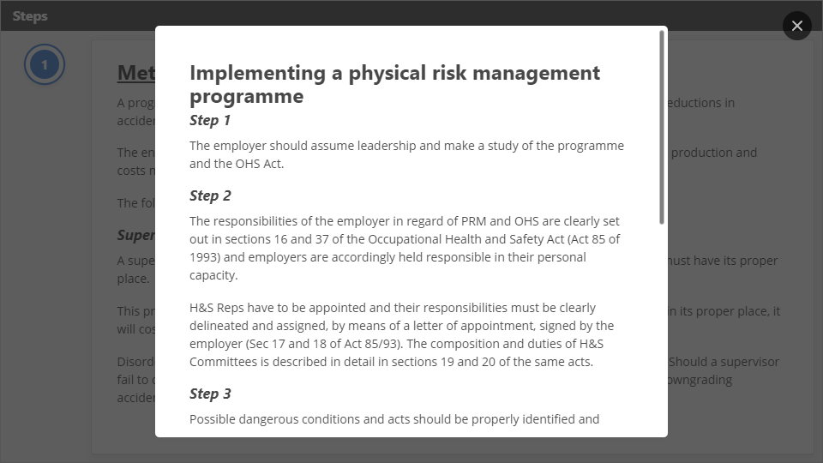
Interaction
Click the Interaction button to edit this object

Slide 79
Supervisor to teach order
The supervisor should teach the meaning and values of order to others by:
Explaining the meaning of order and its benefits to everyone;
Selecting items of disorder for discussion purposes;
Questioning the necessity of disorder-creating items;
Instituting an orderliness campaign; and
Establishing a system to recover unnecessary items of value and returning these to a central point for inventory and value assessment.

Slide 80
Recognise/Reward routine orderliness
A supervisor should try to reinforce good housekeeping practices by rewarding orderliness. Proper recognition of the orderly arrangement of the individual's tools and equipment will soon develop into personal pride of his work and working environment, and this is bound to radiate to the other workers.
Learn by personal observation
With a better understanding and a new insight of what housekeeping or order is really about, the supervisor will be equipped to get many things done in the interest of general efficiency and loss control that he might not otherwise have been motivated to do.
The supervisor will observe disorder through regular inspections and will then be able to make recommendations to prevent downgrading accidents. If a supervisor is going to get order in his operation, the greatest tool he has at his disposal is his everyday opportunity to look around, and to examine everything.
The benefits that can accrue to an organisation applying principles of order are significant. The supervisor in his informal inspections should look carefully at each individual work area, as well as the general areas.
In his search for a lack of order; he must decide whether or not corrective action is necessary to put any area in order; and he must implement action by using whatever help might be required of immediate supervisors to have order instituted and to start its benefits working for him.

Slide 81
SESSION 2 Know how to limit damage to persons or property in the event of an accident or emergency.
The location of fire extinguishers, hoses and alarms is known in a selected work context.
The difference between the different kinds of fire extinguishers in the building is identified and the use for each is identified correctly.
The use of a fire extinguisher is demonstrated competently.
Established procedures relating to the identification of fires and other emergencies are known and followed promptly and correctly in an emergency.
Dangerous occurrences are identified and accurately and timeously reported according to established policy.
Injuries involving individuals are reported promptly to the relevant authority.
Reasons are given to explain why it is the responsibility of every employee to maintain the safety and security of a selected work environment.

Slide 82
Fire Prevention and Fire Protection
Therefore, it is essential that all factory employees are familiar with the basic procedure to be followed in the event of a fire and are trained in the correct use of firefighting equipment
Prevention of fire is usually a matter of
Alertness,
Observation
And an ability to identify potential fire hazards
And then to rectify such hazards.
The key to any effective fire loss control programme is the supervisor. Without him, it is nearly impossible to have a meaningful fire prevention programme.
A business cannot remain in business if the building, the plant and the stock are destroyed by fire. There is certainly no quicker way to destroy a business than by fire.

Slide 83
Causes of fire
There are some main causes of fires:
Electricity
faulty electricity;
open matches and cigarettes;
spontaneous ignition
chemical reactions;
static electricity;
friction etc.

Slide 84
The abuse of electricity is often the cause of a fire: overloading of a wall socket; unattended; temporary wiring; and wires which are frayed. Some examples are electrical appliances left switched on and cables and wires under carpets.
The precautionary measures to be adopted with electricity are
to ensure the wall sockets are not overloaded;
switch off appliances when not in use or unattended;
replace temporary wiring with permanent wires;
do not lead wires under carpets;
let a competent person check factory wiring at regular intervals.
Fires can also be caused by electric heaters which have been left on; also never overload plugs with electrical appliances or place electric heaters near combustible materials such as curtains and other materials which could catch fire.

Slide 85
Sparks
Sparks can also cause fires. The precautionary measures to be adopted when using cutting tools and welding equipment (which could cause sparking) are as follows:
Ensure that any work done on the premises which creates sparks be carried out by a competent person;
Permits must be issued to persons carrying out hot works;
Do not allow flammable liquids in the vicinity of the welding or cutting works.
Spontaneous Combustion
Spontaneous combustion or ignition can also be a cause of fires. Ensure that no oil-soaked rags are left lying around; and provide metal bins for the discarding of old rags.

Slide 86
Elements present to cause fire
These elements usually cause a chain reaction. Remove any of the elements and the fire will be extinguished. Pouring water on the fire will remove the heat. Blanketing it with sand, foam or a chemical will exclude oxygen supply. Cut off the fuel and the fire will extinguish itself,
Classes of fire
There are four classes of fire, namely:
CLASS A ‑ which are mostly wood and paper fires;
CLASS B ‑ which is mainly flammable liquids such as thinners and gasoline;
CLASS C ‑ which is mainly electrical fires; and
CLASS D ‑which is mostly flammable metal fires such as titanium, magnesium and lithium.

Slide 87
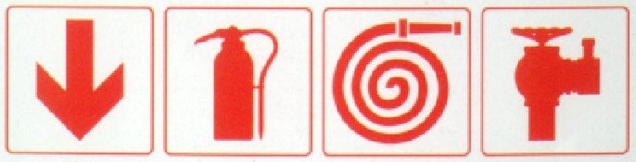
For each class of fire, a different method of extinguishing the fire used, namely:
CLASS A fires usually need soda-acid extinguishers
CLASSB fires usually need foam, dry chemical extinguishers
CLASS C need carbon dioxide or dry chemical extinguishers
CLASS D usually need special chemicals, iron filings and French chalk.
It is essential to note that soda-acid or foam fire-extinguishers must not be used on electrical fires because one must always assume that all electrical installations are live. The water and foam discharged by the fire extinguishers are both conductors of electricity. Thus, the person operating the fire-extinguishers may receive an electric shock.

Slide 88
Evacuation of the work‑place in case of fire
Safety law is concerned with the preservation of life rather than property. For this reason, the following procedure must be followed in the evacuation of property:
All emergency doors should be able to open outwards;
All doors and exits where people are constantly working should be kept clear for emergency evacuation;
There should be easy access to outer escape exits;
Staircases should have proper handrails;
Staircases which are going to be used as fire escapes must not be constructed of combustible materials; they should be kept clear of obstructions; they must not terminate in an enclosed area or cul de sac;
Staircases and passages must be constructed in such a manner that they can be easily negotiated and that easy exit can be facilitated; and there should be at least two means of egress which are situated as far apart as possible.
It’s the duty of the employer to provide on the premises an adequate supply of suitable fire-fighting equipment at strategic locations or as may be recommended by the fire chief of the local authority concerned, and this equipment must be maintained in good working order.

Slide 89
Location of fire-extinguishers
Fire-extinguishers should be placed close to likely fire hazards, but not so close that they can be damaged or suddenly cut off by fires. They should be located outside entrances to danger areas, never inside where they might become inaccessible. They should be placed in conspicuous places, and should be prominently marked by, for example, red paint. The type of paint used must in no sense camouflage the extinguishers.
Portable Fire-Extinguishers
Large signs can be posted where extinguishers are not readily located.
Fire-extinguishers should be checked monthly by a responsible person and should be serviced annually.
The demarcation, accessibility and location must be checked; the cylinders must be visually checked for corrosion or damage; the nozzle must be checked for blockage or dirt; the breather must be checked for blockage; and the rubber hose must be inspected for deterioration, damage and correct coupling.

Slide 90

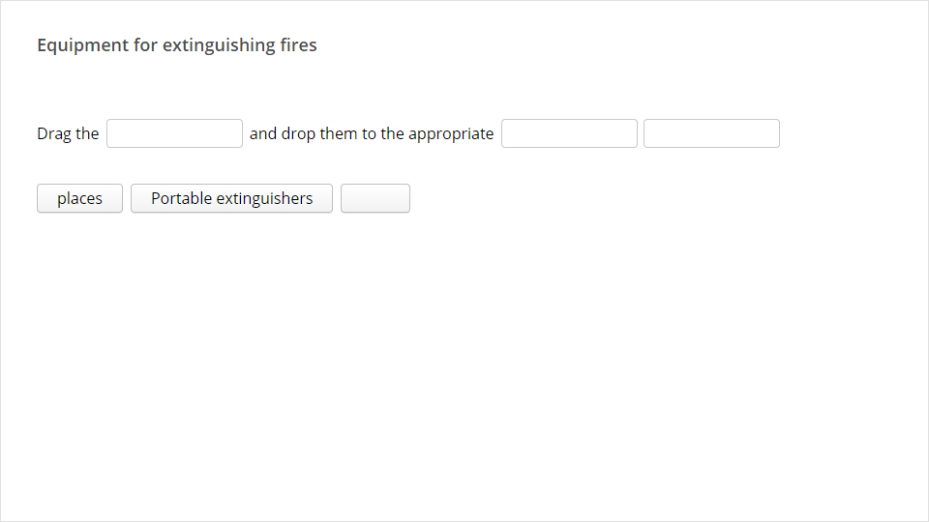
Quiz
Click the Quiz button to edit this object

Slide 91
Water is one of the most basic aids to use in fighting fires and is used worldwide by fire brigades: Reasons:
Cost effective and readily available.
Simple method of transport.
Dependable medium and even fires of combustible liquid can be extinguished with a fine water spray.
Water can be mixed with several agents to form foam.
Water can be found in open (dams, rivers, tanks, wells, private swimming pools); static sources such as surface fire hydrants and underground hydrants (bayonet or ball and floater).

Slide 92
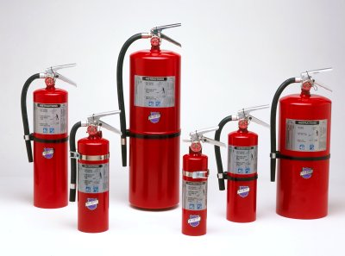
Portable Extinguishers
General Techniques for usage:
Make sure that you use the appropriate extinguisher for the different types of fires.
Test the extinguisher by squirts before approaching a fire.
If possible, approach the fire from downwind.
Aim the spout at the base of the flames.
Use sweeping movements to apply the medium of extinguishing.
Activating the Extinguisher:
CO2 extinguisher
CO2 is the chemical formula for carbon dioxide, a colourless and non-flammable gas that has a slightly acidic taste. Solid carbon dioxide is normally known as dry ice. The CO2 is a multi-purpose extinguisher and can be used on any class fire, especially class C fires (elecricity).

Slide 93
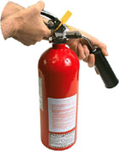
Pressurized water extinguisher
Remove the discharge hose of the container.
Remove the safety mechanism.
Press the hand controlled trigger twice to let the water escape.
DCP extinguisher
DCP stands for dry chemical powder. The agent in this extinguisher is a powder. This is a multi-purpose extinguisher and can by used on any class fire.
The information for the operation of the fire extinuisher is on the lable of the extinguisher. Make sure you know how to use it before a fire breaks out.
General rules for operating a portable fire extinguisher:

Slide 94
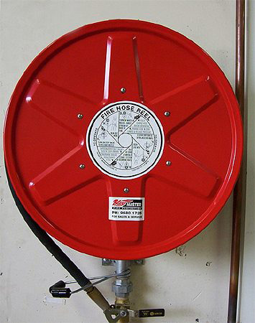
Fire Hose Reels
Fire hose reels are found in many public buildings, e.g. offices, theatres, blocks of flats, shopping centres, factories and storage areas. Used together with portable fire extinguishers this equipment is first to be used in case of fire. It is therefore necessary for all occupants to know how to use this equipment.
Parts of fire hose reel:
A length of usually 30 m of rubber hose.
It has a spout at the end.
Rolled onto a red metal reel.
Usually fixed to a wall with clamps.
It has a valve for opening and closing.
Prominently marked as Fire Hose Reel.
Attached permanently to water supply.

Slide 95
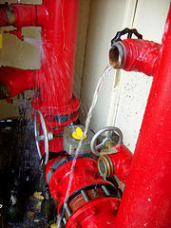
Fire Hydrants
Fire hydrants are connected to the water mains of a town or city. It is for the use of the fire brigade and factory teams to combat fire.
Indicators (marks):
Yellow lines on the road.
The letters F B painted in yellow on the road surface.
Yellow and black labels on poles.
Small poles marked in yellow and red.
Equipment for the fire hydrants:
Keys to lift the lid.
False Toby.
Stand pipe.
Bar and Key.
T-key for surface hydrants.
Fire hoses.

Slide 96
All of this equipment should be checked against the specifications mentioned above on a regular basis. This could be done either by the Health and Safety representative or companies who supply firefighting equipment. They should be checked at a minimum of at least once a month.
General guidelines for the placing of fire extinguishers:
Space the fire extinguishers evenly over the floor area.
The distance between fire extinguishers should not be more than 23 m.
Place the fire extinguishers in clearly visible positions next to escape routes and ensure that the equipment is clearly indicated with symbolic safety signs and is easily accessible.
Fire extinguishers may not create obstructions.
The handles of fire extinguishers may not be more than 1.5 metres above floor level and the base of the extinguisher should not be less than 0.75 metres above floor level.
Fire extinguishers placed outside buildings should preferably be placed in a cabinet.
Fire extinguishers that are located in corrosive atmospheres must be more regularly inspected.

Slide 97
What is individual OHS responsibilities?
Health and safety are the joint responsibility of management and workers. Management is accountable for non-compliance to health and safety legislation. All health and safety activities are based on specific individual responsibilities, most of which can be found in the pertinent legislation. However, often these duties are not well known. This situation can be improved by including details of specific individual responsibilities in the safety program. Responsibility may be defined as an individual's obligation to carry out assigned duties. Authority implies the right to make decisions and the power to direct others. Responsibility and authority can be delegated to subordinates, giving them the right to act for superiors. It is important to note that, while some responsibilities can be delegated, the superior remains accountable for seeing that they are carried out. Individual responsibilities apply to every employee in the workplace, including the Chief Executive Officer. When a safety coordinator has been appointed, it is best to spell out his/her responsibilities as well. All employees will then know exactly what is expected of each individual in health and safety terms.

Slide 98
To fulfil their individual responsibilities, the people must:
know what these responsibilities are (communication required)
have sufficient authority to carry them out (organizational issue)
have the required ability and competence (training or certification required)
Once all these criteria have been met, safety performance can be assessed by each individual's supervisor on an equal basis with other key job elements. Health and safety is not just an extra part of an employee's job: it is an integral, full-time component of each individual's responsibilities.

Slide 99
SESSION 3 Know how to contribute to the maintenance of security in the workplace
Security procedures are known and followed competently.
Security risks are identified and actions taken to deal with security risks that are within limits of own authority.
Potential security risks outside own authority are identified and reported using familiar and established procedures.
Suspicious behaviour is noted and action is taken within own level of authority.

Slide 100
The management of safety programmes is an essential element of any management loss control function. If there is a lack of management control, there could be numerous losses and downgrading incidents, and various other related difficulties. Managers and supervisors have an essential proactive role in loss control, rather than an after-the-loss role, i.e., they have a preventive role. It is necessary for the individual supervisor, in conjunction with the sanction of top management, to practise professional managerial techniques to ensure the optimum control of accidents.
Loss Control Programme
Protection of employees against hardship caused by illnesses and injuries incurred on duty is usually provided for in legislation, e.g. the WORKMEN'S COMPENSATION ACT, 1941 (Act 30 of 1941).
Illnesses and injuries cause interruption/disruption of services and work, and should be prevented wherever and whenever possible, so health risks and safety risks should be eliminated as far as possible. This programme of accident prevention also forms part of loss control as discussed in a previous section.

Slide 101
Programme for injury prevention
Preventing injuries on duty is a function of every employer. Injuries on duty cause losses to an organisation. There should always be a specific programme for the prevention of injuries on duty.
The goals of the programme should be stated clearly; the top executives should identify with the programme and also support it; organisational arrangements should be made for the implementation of the programme; and all employees of all ranks should be trained to prevent injuries.
If top executives are ignorant about measures to prevent injuries on duty, the programmes will fail and no money will be provided for the implementation of the programmes.
All subordinates should be trained on how to handle injuries on duty. They must also be alert and be on their guard against injuries. Workplaces should be so designed that they will prevent or minimize accidents.
Measures to prevent injuries must be enforced and those who deviate from the prescribed procedures must be punished, e.g., the omission to wear protective clothing. Safe working environments must be created, and unsafe machinery should be eliminated or guarded wherever possible. For further details, see a previous lesson on the guarding of machinery.

Slide 102
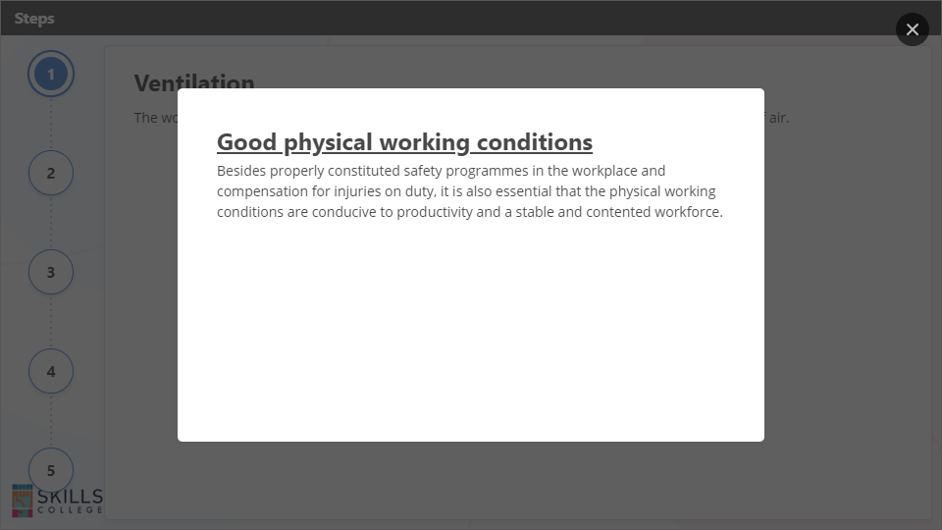
Interaction
Click the Interaction button to edit this object

Slide 103
Health risks
Some of the health risks which are found in the workplace and the substances which cause them are listed below:
Arsenic ‑ lung cancer and lymphoma;
Asbestos ~ white lung diseases, asbestosis, lung cancer, and cancer of other organs;
Benzene ‑ leukemia and aplastic anemia;
Biochrome thioether ‑ lung cancer;
Coal-oven waste ‑ lung cancer and kidney cancer;
Cotton dust ‑ brown lung diseases, chronic bronchitis and emphysema;
Lead ‑ kidney diseases, anaemia and damage to the central nervous system, sterility, birth defects;
Radiation ‑ cancer of the thyroid gland, lungs and legs, and leukaemia;
Carbon waste ‑ black lung disease; and
Benzal chloride - brain cancer and cancer of the liver.

Slide 104
Incidents
Property damage incidents registers and reports
The property damage incidents register is very important. In 1969 a study of industrial accidents was undertaken by L Bird in America.
The study of over 1,7 million industrial accidents reported by nearly 300 companies employing some 1,1 million employees revealed that for every " serious or disabling" injury reported, there are approximately ten (10) injuries of less serious nature.
Also, for every single " serious or disabling injury" there were approximately thirty (30) incidents of property damage and 600 incidents with no visible injury or property damage (No Loss Incidents or " Near misses”). Registers and reports that must be available and up to date at all times:
Incident register
Registers for service lifts, hooks, chains, slings and ropes (steel and sisal) as well as all lifting tackle.
Registers for OHS Reps' monthly safety inspections.
Registers for machine guards (all types).

Slide 105
Reporting of incidents
In terms of Section 24(1) of the OHS Act any employer must report incidents resulting in death or serious injury to an inspector within the prescribed period.
Regulation 8(1) of the General Administrative Regulations states that an employer must, within seven days after an incident referred to in section 24(1)(a) of the Act, give notice thereof to the provincial director in the form of WCL1 or WCL 2. (Prescribed forms)
Reporting of injuries
Injuries to workers are classified" into"
Fatal
Disabling
Non disabling
First Aid only” incidents.
This includes cases where a worker’s health is impaired through poor conditions in the workplace such as poor lighting, ventilation, control of harmful dusts and vapors, vibrations, -radiation etc.

Slide 106
Accidents/incidents that have to be reported to the Dept of Labour
It is best to refer to Section 24 of the Act, which describes in detail what type of accidents/incidents should be reported to the department of Labour. The matter should be reported as soon as possible either by means of telegram, fax or telephone.
It is recommended that the Department of Labour be informed along official channels; the process will go quicker if the Regional Representative of the Department of Labour is contacted by the contractor.
As broad guideline, the Department of Labour has to be notified in any instance where:
A person has lost consciousness; has lost a limb or any part thereof; has been killed or would likely succumb as result of the injuries sustained;
A person has been injured to such an extent that he/she would be unable to resume normal duties after a recuperation period of 14 days;

Slide 107
Workmen’s Compensation
Workers who are injured or contract a disease through their work are able to claim money from the Compensation Fund. Families can also claim if their breadwinner died through work related disease or injury.
Who can claim worker's compensation?
The Compensation Fund covers workers who:
were hurt in an accident while they were busy with their work
contracted a disease through their work
died from a workplace accident or occupational disease.

Slide 108
Who pays into the fund?
Employers pay into the Compensation Fund once a month. Workers do not pay anything to the Fund. Employers cannot deduct money from workers' wages as contributions to the Fund.
What injuries and diseases are covered?
The Fund covers occupational diseases and workplace injuries. Occupational diseases are illnesses caused by substances or conditions that the worker was exposed to at the workplace. You can claim compensation if you are exposed to these working conditions and then get the related disease.
You can claim for other disease if you can prove using medical evidence and reports that the disease was caused by conditions at work. The Fund also covers injuries that were sustained as a result of work or at the workplace.

Slide 109
How do you claim compensation for occupational injuries or diseases?
This is a step by step procedure to claim compensation for any injuries or diseases:
Inform you supervisor or employer as soon as possible (verbally or in writing). Make note of anyone who witnessed the accident.
You complete the following form: WCL 2 - Notice of Accident and Claim for Compensation. (Your employer is required to have copies of the relevant forms to claim for compensation).
Your employer must then report the accident to the Compensation Commissioner, (even if they don’t believe your story), by submitting Form WCL 3: Employer's Report of Accident.
Your employer must report a workplace injury within 7 days or within 14 days of finding out that you have an occupational disease.
You should check that all the details on the form are correct.
Within 14 days of seeing you, the doctor must fill in form WCL4 stating how serious the injury was and how long the worker is likely to be off work. This is sent to the employer who sends it to the Commissioner.

Slide 110
Claims will not be paid if:
The claim is made more than 12 months after the accident or death, or after the disease is diagnosed.
You are off work for 3 days or less.
The accident resulted from your own wrong doing (Unless the worker is seriously disabled or dies in the accident, then the Fund will still pay compensation).
You unreasonably refuse to have medical treatment.
Where must the claims be sent to
All forms that need to be submitted to the Commission can be sent to:
Compensation Commissioner
PO Box 955
Pretoria
0001

Slide 111
SESSION 4 Explain emergency procedures in the workplace
The established policy is known and understood for emergencies in the building.
The location of the planned assembly points and the shortest routes to such points are known and the building is evacuated along the correct route.
The emergency signage in the building is interpreted correctly.
Emergency procedures are explained in a familiar context.
Actions to assist an injured or sick person in an emergency are demonstrated in a limited range of familiar contexts.
Precautions for dealing with HIV/AIDS in a workplace emergency are known and described in terms of the Universal Precautions.

Slide 112
What are elements of the emergency plan?
The emergency plan includes
all possible emergencies, consequences, required actions, written procedures, and the resources available
detailed lists of personnel including their home telephone numbers, their duties and responsibilities
floor plans, and
large scale maps showing evacuation routes and service conduits (such as gas and water lines).
Since a sizable document will likely result, the plan should provide staff members with written instructions about their particular emergency duties.

Slide 113
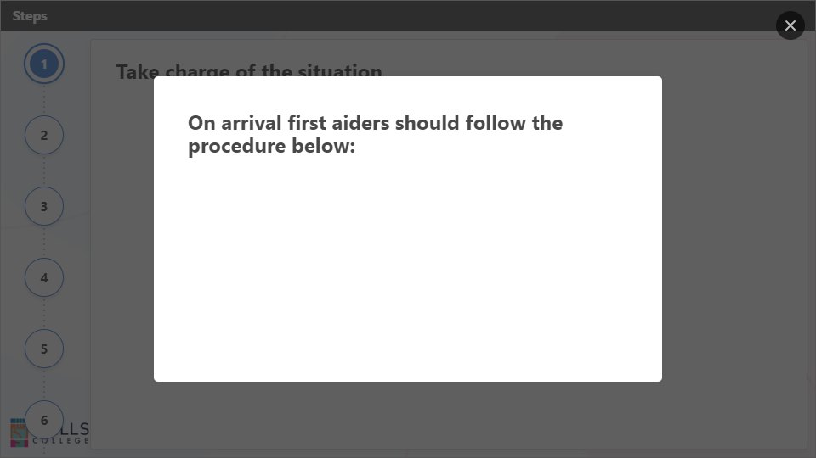
Interaction
Click the Interaction button to edit this object

Slide 114
These require special and careful attention
Untrained staff | At no time should untrained personnel be allowed to administer first aid in an emergency situation as this could seriously increase the severity of the injuries and result in unnecessary death.

Slide 115
Recognising an Emergency
Emergency situation | Emergency situations are as a result of accidents, illness, fire/flood and chemical contamination. Recognising an emergency situation quickly and correctly is critical to saving lives. In the table below are the visible signs and symptoms indicative to recognising emergency situations:

