Slide 1
PURPOSE
This Unit Standard provides a broad introduction to the correct use of basic equipment used in the insurance industry. The focus is knowledge, skills, values and attitudes in relation to the learner's own context and experience of the world of work. The qualifying learner is capable of.
Following instructions to operate office equipment:
Maintain equipment in a clean and working condition.
Monitor and request equipment consumables.
Recognise and take steps to minimise risks to safety when operating equipment in an office environment.
LEARNING ASSUMED TO BE IN PLACE
It is assumed that the learner should : Hold a GETC or equivalent qualification; or
Be competent in communication and mathematical literacy NQF level 1.

Slide 2

Follow instructions to operate office equipment
SESSION 1

Slide 3

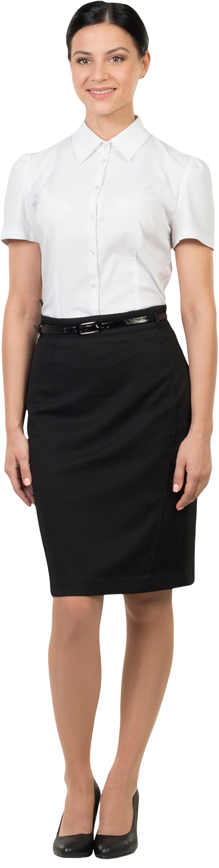
To function as an effective and productive member of your organisation, it is important that you know how to select equipment that is appropriate for the task, and then use it in accordance with designated instructions. The maintenance of that equipment is also critical to ensure that it is always operational.

Slide 4

At the end you should be able to:

Slide 5
select and use equipment appropriate to the task according to organisational procedures and manufacturers’ instructions
store and dispose of equipment and materials in accordance with organisational procedures
deal with issues and problems arising from the operation of equipment in accordance with organisational protocol
undertake training to use particular equipment as needed.

Slide 6
The equipment used in own area of responsibility is identified in terms of function.

Slide 7
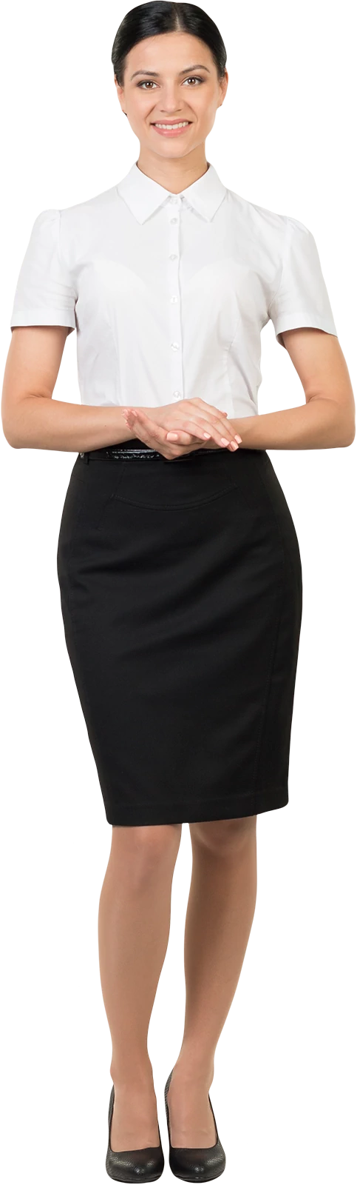
Workplace equipment and machines
As a communities and disability services worker you may use a range of office equipment, specialist equipment to support clients with a disability, or technology to support communication in rural and remote areas. There may be a great variation in the operating procedures and maintenance tasks associated with workplace equipment.

Slide 8
Examples of typical office equipment include
telephone, fax, photocopiers and pagers
security systems and intercoms
television, video and CD players, cameras
computers, printers, scanners and other peripherals.
Your organisation may also have equipment for specific purposes, such as:
assistive devices for people with a disability
video/audio-conferencing equipment to connect remote sites
4WD vehicles for working in remote areas.

Slide 9
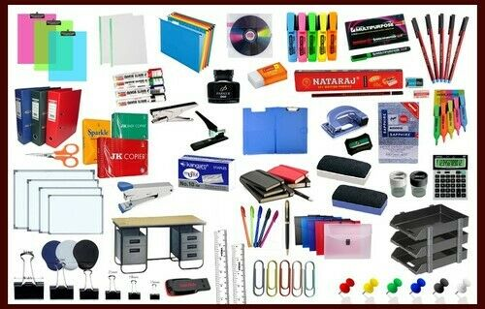
Stationary
Stationary is a traditional part of the office environment, and continues to be essential in the 21st century. Stationary includes items such as pens, rulers, staplers, paperclips and other equipment used to make notes and perform basic tasks connected to activities such as idea brainstorming and recordkeeping, for example. Notepads are commonly used to record minutes in meetings, while post-it notes are used to communicate short messages effectively within the office. post-it notes are used to communicate short messages effectively within the office.

Slide 10
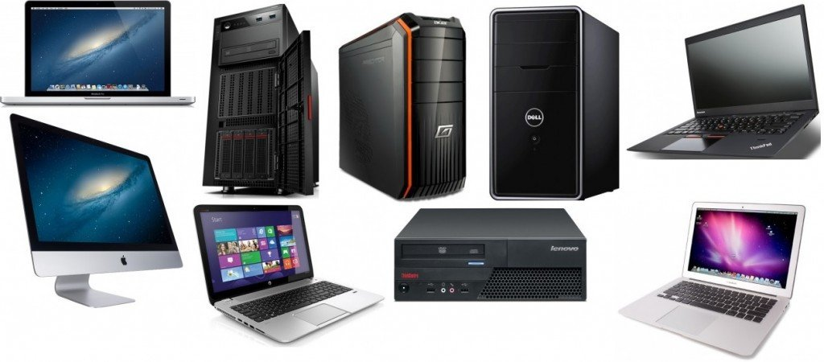
Computers
Computers are used for a large amount of office-based tasks. Word processor programs are utilized to type up notes and minutes and to produce reports and communications, while spreadsheet programs will be used in account keeping. Computers allow access to the Internet, which provides both internal and external communication tools in the form of e-mail, as well as immense research capabilities. The type of computer used by an office will vary based on what work is required. A more up-to-date computer will be needed for desktop publishing and graphics production packages, for example, while office workers may use laptops, especially if they regularly work while on the move.

Slide 11
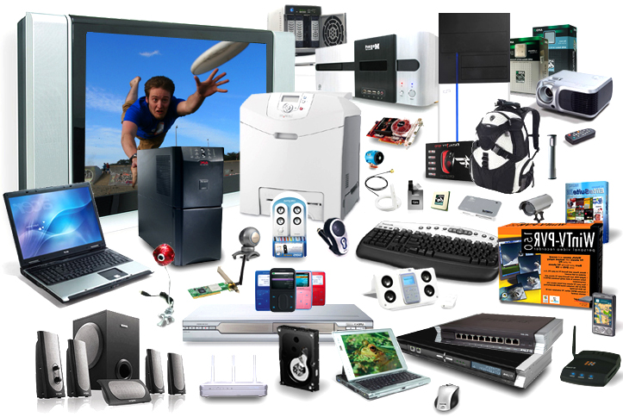
Computer-based Hardware
Several commonly found pieces of office equipment are designed for use alongside computer systems, and are typically connected to them. These include printers, which enable office workers to produce hard copies of documents such as reports and accounts, and scanners. Scanners allow professionals to reproduce documents and graphics onto computers in digital form, for example for use on a company website, and are available in a range of resolutions which offer varying levels of detail. More expensive scanners, those with resolutions of 3200 DPI (dots per inch) and more, are suitable for graphic designers and professionals in similar fields.

Slide 12
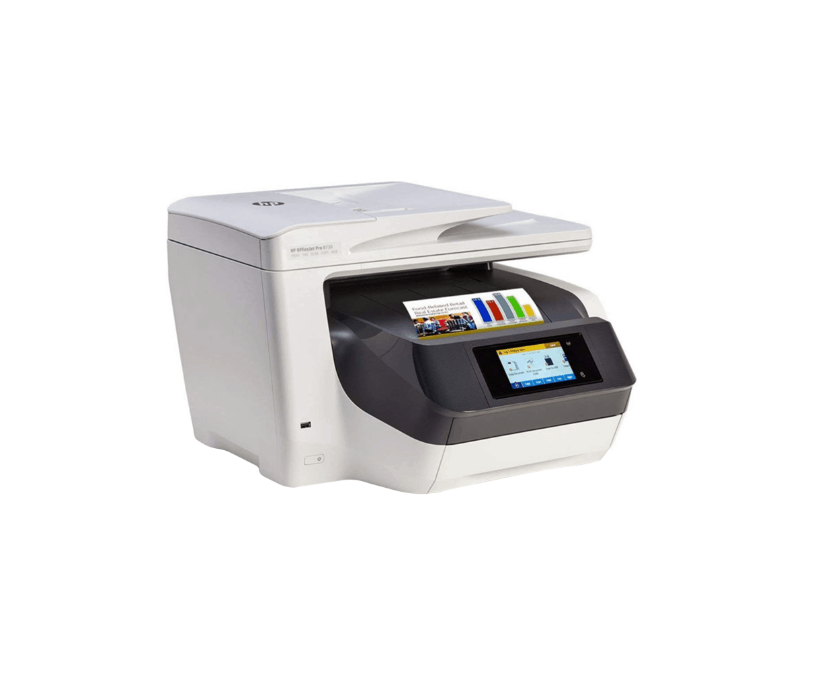
Document Manipulation
Other useful machines generally found in offices include the photocopier, which allows workers to make multiple copies of a document for reference and for sharing with colleagues, and shredders. The shredder is increasingly important with the prevalence of identity fraud. Shredders are used to destroy documents containing potentially important information about an individual's or company's accounts, preventing would-be fraudsters from using this information.

Slide 13
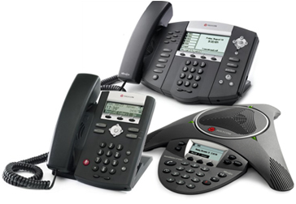
Communications
Professionals need to communicate with individuals both within their company and outside, so most offices will utilize a telephone system. This system will connect all of the workers in the office together and will have built-in features, which enable an individual to divert a call to a colleague, for example. Other functions of phone systems include conferencing, which allows multiple workers to join in the same conversation, and message recording capabilities. Professionals might also use advanced cell phones, such as BlackBerry devices, while away from their desk.

Slide 14
There will be specific operational, maintenance and safety requirements for use of this equipment. These are often posted near the equipment, or provided in the manufacturer’s instructions, or during workplace training.

Slide 15
Your organisation will also have protocols and procedures regarding who can use the equipment and for what purposes.

Slide 16
Instructions for operating equipment are understood and followed responsibly with due regard for safety.

Slide 17
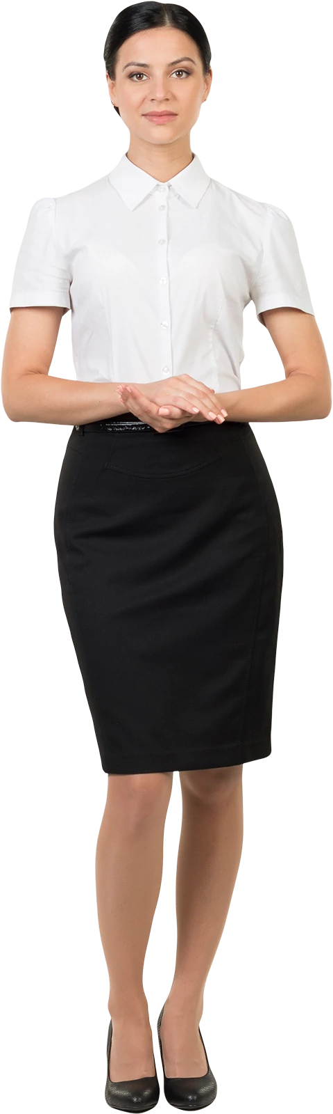
Training
If you do not know how to use a piece of equipment in your organisation, it’s a good idea to ask for training in how to operate it correctly.

Slide 18
The training should include instructions for safe use and any related workplace procedures or protocols. Examples of equipment requiring training could include the following on the next slide :

Slide 19
computers and computer systems
common office equipment such as photocopiers and faxes
equipment used to communicate between remote sites
specific equipment, or equipment adapted for assisting clients with a disability.

Slide 20
If your organisation replaces an existing piece of equipment with a newer model or different brand, you should receive training in operating the new equipment. Policies, procedures and protocols for accessing training in your workplace could include:

Slide 21
a requirement to develop a personal training plan
procedures for requesting training
approval of costs and time off work to attend training courses
mandatory training for certain equipment.

Slide 22
If your organisation is very small or in a remote location, you may need to travel to a training venue, complete training online, or have a co-worker teach you.

Slide 23
A method of documenting and tracking equipment purchases
Systems for inventory
Master inventory sheet contains all pertinent information
Detailed inventory forms may include
Name of equipment
Description
Model and registration numbers
Date and place of purchase
Product warranty and estimated life
Maintenance and service contracts

Slide 24
Common problems or faults that occur on a routine basis are identified and solved following the manufacturer's instructions.

Slide 25
Computers run slow
May be due to: (1) hardware configuration too: Computer CPU, motherboard, memory configuration is too low, run the program will be very slow. By increasing the memory (at least more than 256M) and other ways accelerate. But the computer is usually 3 to 5 years should be updated. (2) System poisoning: a computer even without Internet access should also install antivirus software, such as anti-virus software can not remove the virus, you must reinstall the operating system (Windows). (3) System disk (C drive) is too small: if the drive is bigger, if the C drive is too small, too slow will cause the program to run, C drive capacity should be at least 8G or more. Proposed re-allocation of C driving capacity.

Slide 26
Desktop computer is usually too loud
CPU fan or power supply cooling fan failure causes abnormal sound, you can replace the cooling fan.
Printer or fax machine does not feed paper
May be due to: 1, paper thin (80 grams), thick (150 grams) or uneven. 2, the pickup roller (Pick-Roller) fault, not the paper into the machine, you need to repair or replace the parts.
If the fax machine or a fax copy manuscript lines appear black lines, it is likely to be contaminated scanner (usually coated with a manuscript result in correction fluid).
Open the machine front panel, use cotton balls dipped in alcohol or water cleaning the bottom of the long strip of transparent glass article.

Slide 27
Copier from copying line feeder
Above copiers ADF, you can also copy several dozen articles. If the manuscript copy from the feeder lines appear black, while the copy does not appear from the cover bottom lines, it is likely to be below the scanner feeder to be contaminated. Can be pushed from the feeder, see the draft of a long strip sets side of the transparent glass, with a cotton ball dipped in alcohol or water to clean it.

Slide 28
Persistent and non-routine problems/faults that require specialist technical skills are recognised and reported to the relevant authority.

Slide 29
Equipment faults
Equipment faults, need to be accurately identified and prompt action needs to be taken to address the fault through either:

Slide 30
routine repair in accordance with manufacturer's instructions, or
through reporting the fault to the nominated person or section.

Slide 31
In the modern office, there is a reliance on computer and technology to allow daily functions to be performed. Faults or unserviceable, equipment can reduce productivity, considerably. Therefore, prompt and suitable action needs to be taken when faults are identified.

Slide 32
1. Adequate practical knowledge of office staff - It doesn't really take a genius to troubleshoot common office equipment problems, especially when the staff have sufficient technical familiarity, common sense will also do, with these equipment.
2. Regular maintenance checks - Prevention is better than cure. Habitual check-ups of your office equipment keep them well-oiled, so to speak, and avoid any possible downtime. Although, of course, it doesn't really make it foolproof, you're definitely reducing any possible downtime.
3. Quality office equipment - Quality comes with a price, that's a fact. However, in the long run, it may prove to be a more practical choice than purchasing a lesser priced counterpart. With these tips, you will be sure to have lesser occurrences of downtime and a longer life for your office equipment. You save money by not calling in maintenance for every little technical problem that arises. You can also save money when there is less downtime at the office.

Slide 33

Very well then we are done with our first session see you in the next one bye!

