Slide 1
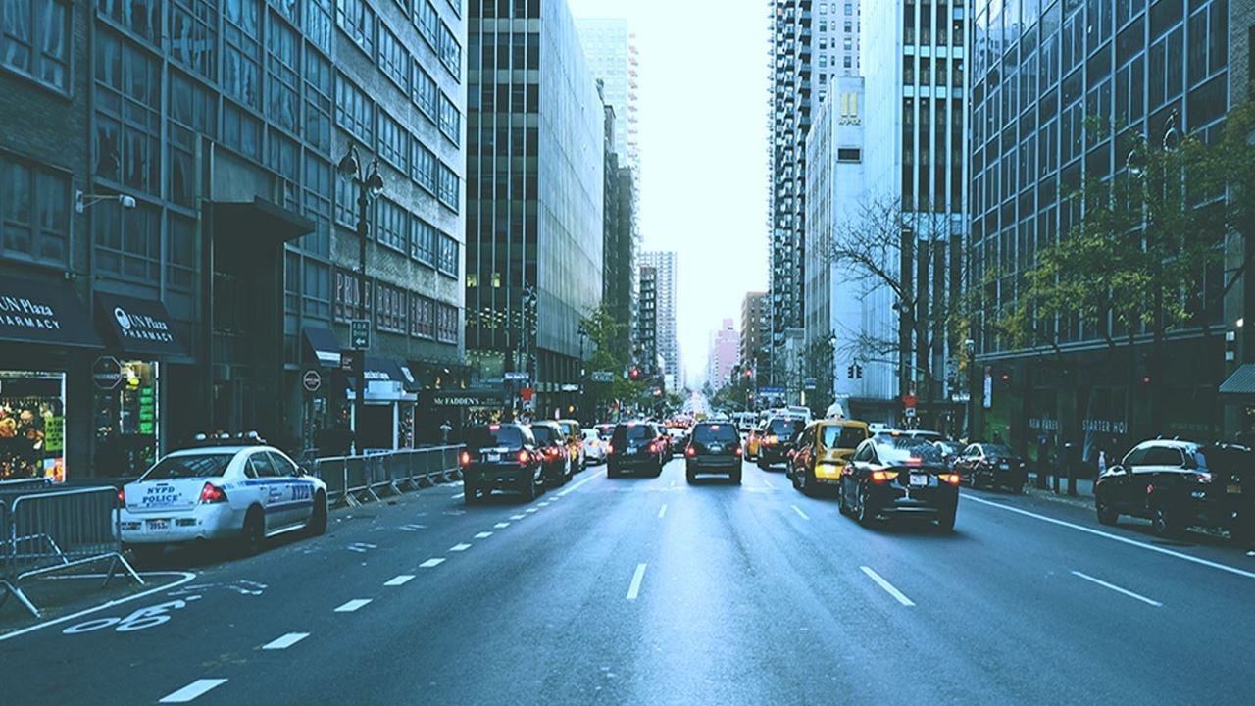
BUSINESS SKILLS
Keep informed about current affairs related to one`s own industry
UNIT STANDARD NUMBER : 14341
LEVEL ON THE NQF : 2
CREDITS : 4

Slide 2

PURPOSE
This unit standard provides a broad introduction to the business environment. It is the starting point for a learner new to the industry they are working within. The focus is knowledge, skills, values and attitudes in relation to the learner`s own context and experience of the world of work. The qualifying learner is capable of:
Identifying events in the physical, social and business environment that impact on the industry in which they are working
Identifying people and business trends from the news

Slide 3


SESSION 1
Identify events in the physical environment that could impact on a selected industry
The term physical environment is understood and a list is made of possible events related to the physical environment.
Information relating to current events in the physical environment is collected and organised demonstrating basic processing of readily available information.
A brief indication is given of how each event could impact on the selected business sector.
The ways in which the selected industry could be affected by such an event are named for three different sub-sector/s of the industry.

Slide 4

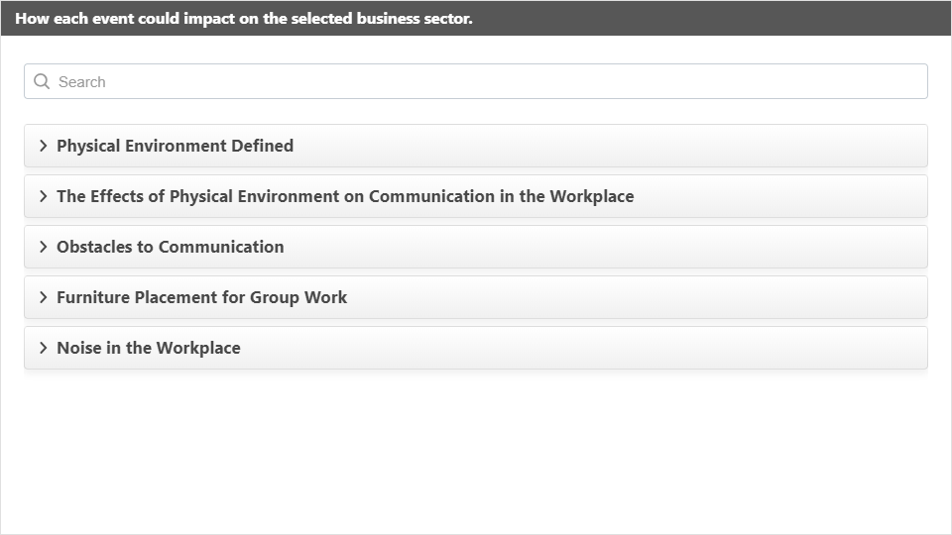
Interaction
Click the Interaction button to edit this object

Slide 5
Let’s now take a brief look at these varied environmental influences.

Slide 6
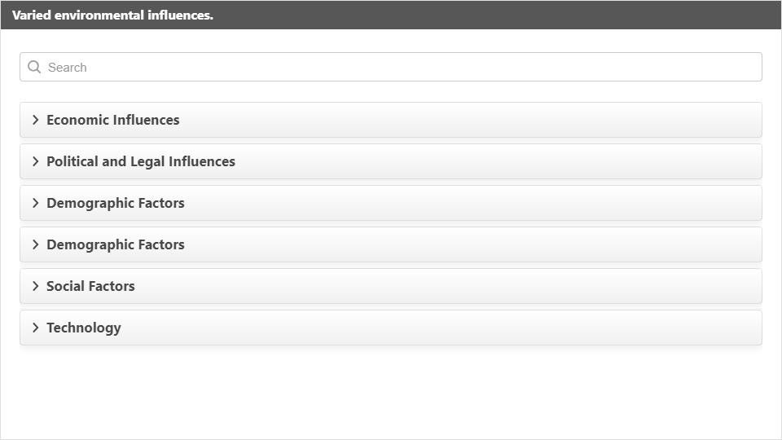
Interaction
Click the Interaction button to edit this object

Slide 7

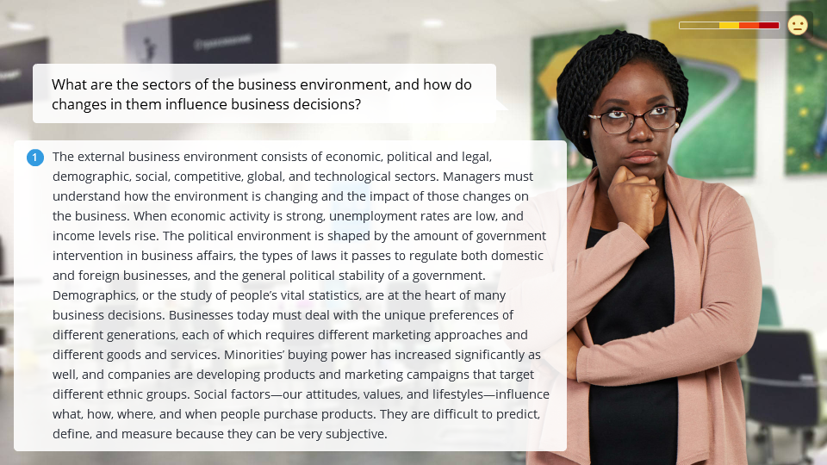
Simulation
Click the Simulation button to edit this object

Slide 8

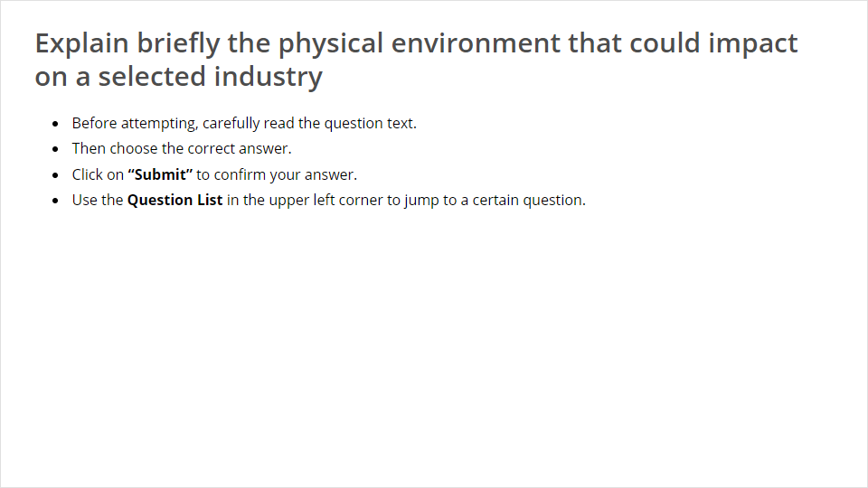
Quiz
Click the Quiz button to edit this object

Slide 9
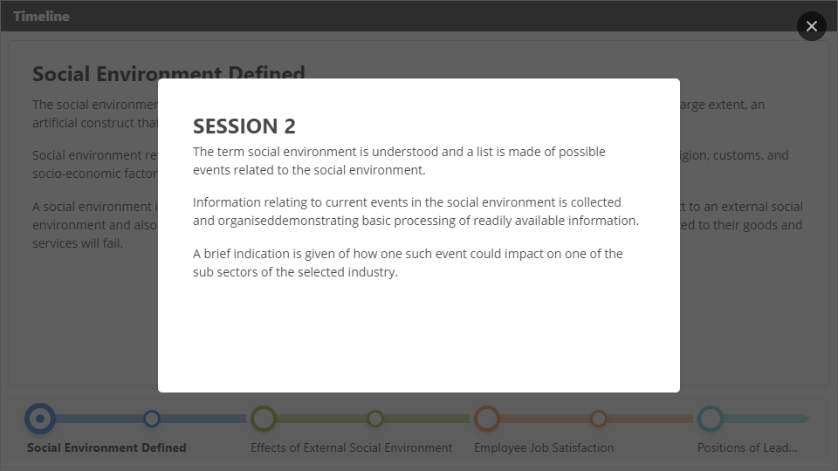
Interaction
Click the Interaction button to edit this object

Slide 10
Impact of Social environment on Business:
Caste – Competitive trading, Weaving, Metal, finance communities
Religion – Prohibition on Pork & Meat, Islamic finance
Customs – Women employment, restriction on overseas employment
Class Structure - Upper, Middle, Manual class
Social mobility – Middle to upper, Manual to Middle etc.
Poverty – Low purchasing power
Social Indicators:
1. Longevity & Health
2. Education
3. Standard of Living

Slide 11
Social responsibility of Business:
Business is affected by society and vice-versa. Society includes Internal & External segments.
Internal segment - owners & employees.
External segment – competitors, customers, suppliers, Government, Local community. No business can be in conflict with any of these segments. Hence the business has to take care of societal interest.
Responsibility to Owners:
Protect capital, provide fair return to owners, ensure longevity of business, Transparency in the operation of business

Slide 12
Responsibility to Employees:
Employees are key recourses of business. Hence fair compensation, welfare, training, development have to be provided
Responsibility to Consumers:
Consumers are the foundation of business. A dissatisfied customer is a warning signal to business. The business has to ensure the following rights of customers:
1. Right to safety – Provide safe products
2. Right to product knowledge & Education – Provide through advertisements
3. Right to product choice – Avoid monopoly
4. Right to full value – Ensure product utility & performance as advertised
5. Right to justice – Through Consumer Protection Act

Slide 13
Responsibility to Suppliers:
A good relation with suppliers is essential for quality and continuous supply of raw materials and other inputs for continuous production. Responsible business avoids the following:
1. Unfair Practices – Break contract, Delay payment, take advantage of loopholes
Responsibility to Competitors:
To engage in healthy competition, the good business strategies & practices of competitors should be learned and should not engage in the following:
1. Competitors brand assassination
2. Restrictive trade practices – Price discrimination, tie-up sale, exclusive dealership
3. Unfair trade practices- misleading advertisement, tricky prices, unreasonable product guarantee.

Slide 14
Responsibility to Government:
Responsible companies are good corporate citizens. They contribute to the development of industry and economy. These responsibilities include:
1. Pay taxes
2. Provide data
3. Implement government schemes
4. Give preference to government companies
These companies find easier to obtain license, credit from public and supply order from government.
Responsibility to Local community:
Local support is important. The local population suffers due to companies such as water, land, pollution. Hence companies should compensate indirectly by providing infrastructure, education, forestation etc.

Slide 15
Environmental Cost Audit
It is the method to understand and evaluate
1. How the environment is affected by company’s operation
2. What are the losses both in terms of money and resources that is getting affected by the company’s operation
3. How company can contribute to mitigate the loss to society and
4. To assess the performance of organisations with respect to its social responsibility.
This is done through reporting of various responsibilities undertaken by organisations. The reporting is done on various factors viz.
1. Social factors
2. Ecological factors
3. Geographical factors
4. Natural calamities

Slide 16
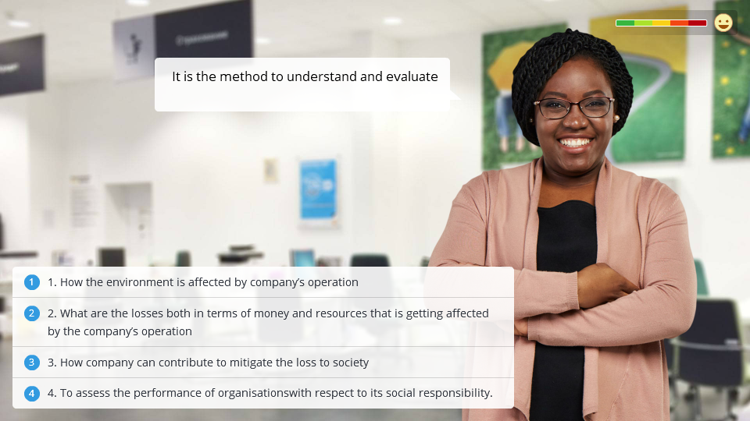
Simulation
Click the Simulation button to edit this object

Slide 17
Social factors:
a. Consumer care
Labeling Quality, quantity, price etc.
b. Environmental care
Upkeep waste, disposal, noise, etc.
c. Society care
Contribution to education, health etc.
d. Community care
Providing water, road, power, job etc.

Slide 18
Summary
Major factors of society and their impact on business is shown below-
1. Educational institutes- educational institutes act as major element of society and participate in framing the inner look of a social system. Educational institutes provide education, knowledge, awareness and judgment capabilities. For example- if in schools teachers tell the students to stop drinking tea due to its hazardous effects on human body, then it is quite possible that majority of students will develop learning against the tea. So, they will stop drinking tea, which will reduce the sales of tea in market.
2. Family- Family is the chief element of society. From the birth of a person till his/her death, he/she live in family, so family’s impact on the decision making of individuals can never be avoided. In traditional countries like India, the influence of family on purchasing decision of a person is extremely important to study, because in India when a person go for shopping, he/she always take his/her family along either physically or mentally. For example- In India while purchasing a car, a person always give attention to the choice of his/her wife, children and parents, but in USA it is a personal decision. The extent to which the family influences a consumer’s decision depends upon the nature of society itself.
3. Religion- Religion is a system through which people believe in God. Religion put considerable impacts upon the purchasing decision of people. For example- Majority of Hindus doesn’t eat non-vegetarian food and strictly avoid beef consumption and Muslims don’t eat pork. Mc Donald’s had to change their non-vegetarian menu after entering India. They removed beef and pork from their menu and introduced new vegetarian products for Indian consumers.
4. Culture- Culture is a set of complex forces that guide the flow of behavior of the people belonging to a particular cultural community. Cultural believes put large impact upon the consumption behavior of consumers. For example in Indian culture female are supposed to not drink and smoke, so advertisement agencies never focus on women while advertising alcohol and cigarettes in India.

Slide 19
SESSION 3
Identify events in the economic environment that could impact on a selected business sector
The term economic environment is understood and a list is made of three possible events related to the economic environment.
Information relating to current events in the economic environment is collected and organised demonstrating basic processing of readily available information.
A brief indication is given of how one such event could impact on one of the sub-sectors of the selected business sector.
The groups of people and kinds of work most likely to be affected are identified for each event.

Slide 20
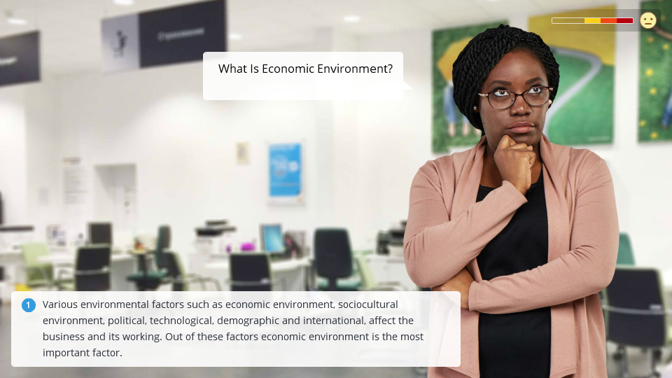
Simulation
Click the Simulation button to edit this object

Slide 21
Elements of Economic Environment
It has mainly five main components:
1. Economic Conditions
2. Economic System
3. Economic Policies
4. International Economic Environment
5. Economic Legislations
Economic Conditions:
Economic Policies of a business unit are largely affected by the economic conditions of an economy. Any improvement in the economic conditions such as standard of living, purchasing power of public, demand and supply, distribution of income etc. largely affects the size of the market. Business cycle is another economic condition that is very important for a business unit. Business Cycle has 5 different stages viz. (i) Prosperity, (ii) Boom, (iii) Decline, (iv) Depression, (v) Recovery.

Slide 22
Following are mainly included in Economic Conditions of a country:
I. Stages of Business Cycle
II. National Income, Per Capita Income and Distribution of Income
III. Rate of Capital Formation
IV. Demand and Supply Trends
V. Inflation Rate in the Economy
VI. Industrial Growth Rate, Exports Growth Rate
VII. Interest Rate prevailing in the Economy
VIII. Trends in Industrial Sickness
IX. Efficiency of Public and Private Sectors
X. Growth of Primary and Secondary Capital Markets
XI. Size of Market

Slide 23
Economic Systems:
An Economic System of a nation or a country may be defined as a framework of rules, goals and incentives that controls economic relations among people in a society. It also helps in providing framework for answering the basic economic questions. Different countries of a world have different economic systems and the prevailing economic system in a country affect the business units to a large extent. Economic conditions of a nation can be of any one of the following types:
1. Capitalism: The economic system in which business units or factors of production are privately owned and governed is called Capitalism. The profit earning is the sole aim of the business units. Government of that country does not interfere in the economic activities of the country. It is also known as free market economy. All the decisions relating to the economic activities are privately taken. Examples of Capitalistic Economy: - England, Japan, America etc.

Slide 24
2. Socialism: - Under socialism economic system, all the economic activities of the country are controlled and regulated by the Government in the interest of the public. The first country to adopt this concept was Soviet Russia. The two main forms of Socialism are: -
(a) Democratic Socialism: - All the economic activities are controlled and regulated by the government but the people have the freedom of choice of occupation and consumption.
(b) Totalitarian Socialism: - This form is also known as Communism. Under this, people are obliged to work under the directions of Government.
3. Mixed Economy: - The economic system in which both public and private sectors co-exist is known as Mixed Economy. Some factors of production are privately owned and some are owned by Government. There exists freedom of choice of occupation and consumption. Both private and public sectors play key roles in the development of the country.

Slide 25
Economic Policies: - Government frames economic policies. Economic Policies affects the different business units in different ways. It may or may not have favorable effect on a business unit. The Government may grant subsidies to one business or decrease the rates of excise or custom duty or the government may increase the rates of custom duty and excise duty, tax rates for another business. All the business enterprises frame their policies keeping in view the prevailing economic policies. Important economic policies of a country are as follows:
1. Monetary Policy: The policy formulated by the central bank of a country to control the supply and the cost of money (rate of interest), in order to attain some specified objectives is known as Monetary Policy.
2. Fiscal Policy: It may be termed as budgetary policy. It is related with the income and expenditure of a country. Fiscal Policy works as an instrument in economic and social growth of a country. It is framed by the government of a country and it deals with taxation, government expenditure, borrowings, deficit financing and management of public debts in an economy.
3. Foreign Trade Policy: It also affects the different business units differently. E.g. if restrictive import policy has been adopted by the government then it will prevent the domestic business units from foreign competition and if the liberal import policy has been adopted by the government then it will affect the domestic products in other way.
4. Foreign Investment Policy: The policy related to the investment by the foreigners in a country is known as Foreign Investment Policy. If the government has adopted liberal investment policy then it will lead to more inflow of foreign capital in the country which ultimately results in more industrialization and growth in the country.
5. Industrial Policy: Industrial policy of a country promotes and regulates the industrialization in the country. It is framed by government. The government from time to time issues principals and guidelines under the industrial policy of the country.

Slide 26
Global/International Economic Environment: The role of international economic environment is increasing day by day. If any business enterprise is involved in foreign trade, then it is influenced by not only its own country economic environment but also the economic environment of the country from/to which it is importing or exporting goods. There are various rules and guidelines for these trades which are issued by many organizations like World Bank, WTO, United Nations etc.
Economic Legislations: Besides the above policies, Governments of different countries frame various legislations which regulates and control the business.
The economic environment consists of external factors in a business market and the broader economy that can influence a business. You can divide the economic environment into the microeconomic environment, which affects business decision making - such as individual actions of firms and consumers - and the macroeconomic environment, which affects an entire economy and all of its participants. Many economic factors act as external constraints on your business, which means that you have little, if any, control over them. Let's take a look at both of these broad factors in more detail.

Slide 27
Macroeconomic influences are broad economic factors that either directly or indirectly affect the entire economy and all of its participants, including your business. These factors include such things as:
Interest rates
Taxes
Inflation
Currency exchange rates
Consumer discretionary income
Savings rates
Consumer confidence levels
Unemployment rate
Recession
Depression

Slide 28
Microeconomic factors influence how your business will make decisions. Unlike macroeconomic factors, these factors are far less broad in scope and do not necessarily affect the entire economy as a whole. Microeconomic factors influencing a business include:
Market size
Demand
Supply
Competitors
Suppliers
Distribution chain, such as retail stores

Slide 29

Simulation
Click the Simulation button to edit this object

Slide 30
Interest Rates
A rate that is charged or paid for the use of money.
· Recession
During this period, interest rates tend to fall during the months of recession to stimulate the economy by offering cheap rates at which to borrow money. People are therefore encouraged to spend money rather than save, as saving will give them a poor return on their money, and so that the economy will grow.
· Growth
In times of growth, interest rates tend to rise thus encouraging people to save money rather than spend. Because the interest rate is higher, then people get more for their money if they choose to save.

Slide 31
Inflation Rates
Represents the general increase in prices. Inflation is a sustained increase in the average price level of a country. The rate of inflation is measured by the annual percentage change in the level of prices. For example, a small company borrows capital from a bank to buy new assets for their business, and in return the lender receives interest at an interest rate for deferring the use of funds and instead lending it to the borrower. Interest rates are normally expressed as a percentage of the principal for a period of one year

Slide 32
SESSION 4
Identify people and companies in the news
Achievements of people and companies in the selected business sector in the news are identified with examples of why they are newsworthy.
Problems in the industry and possible causes for the problems are identified with examples.
New developments in the industry are discussed with examples.

Slide 33
Industry Problems
Sanral to forge ahead with tolls
13 November 2011
Pretoria – The SA National Roads Agency Limited (Sanral) is contractually obliged to bring the Gauteng tolling system into operation unless its instruction from government should change.
This is according to project leader Alex van Niekerk in the wake of criticism that the agency is proceeding to distribute e-tags before the public hearings on the controversial system have concluded.
Various organisations, including the South African Vehicle Rental and Leasing Association (Savrala), the Automobile Association (AA), trade union Cosatu, the DA and the VF+ have been dissuading the public from obtaining the tags – in protest against the system.
According to Van Niekerk the registration process started off slowly this week, just as do such systems globally. On Monday there were 300 registrations. It's not known how many tags have been sold to date.

Slide 34
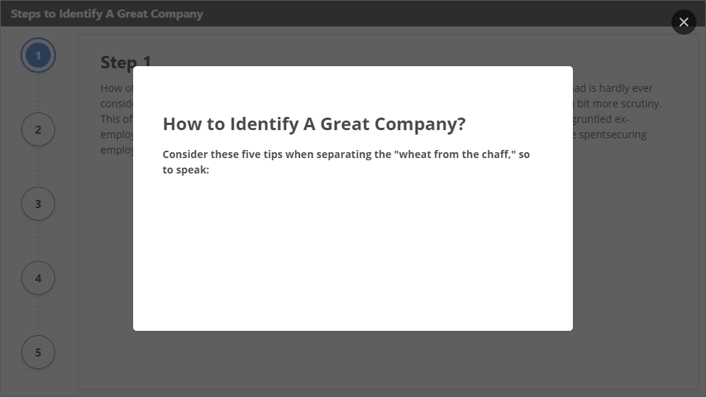
Interaction
Click the Interaction button to edit this object

Slide 35
The Importance of Company News
Everyday life starts with an all- important task of reading newspaper for most people around the world. There are different kinds of news flashed in newspapers and journals every day that provides different kinds of information about the world.
- Political affairs
- Current affairs
- Business and trade news
- Company news
- Economic activities
- Social and cultural affairs

Slide 36
Concept of Industrial Relations:
The term ‘Industrial Relations’ comprises of two terms: ‘Industry’ and ‘Relations’. “Industry” refers to “any productive activity in which an individual (or a group of individuals) is (are) engaged”. By “relations” we mean “the relationships that exist within the industry between the employer and his workmen.” The term industrial relations explain the relationship between employees and management which stem directly or indirectly from union-employer relationship. Industrial relations are the relationships between employees and employers within the organizational settings. The field of industrial relations looks at the relationship between management and workers, particularly groups of workers represented by a union. Industrial relations are basically the interactions between employers, employees and the government, and the institutions and associations through which such interactions are mediated.

Slide 37
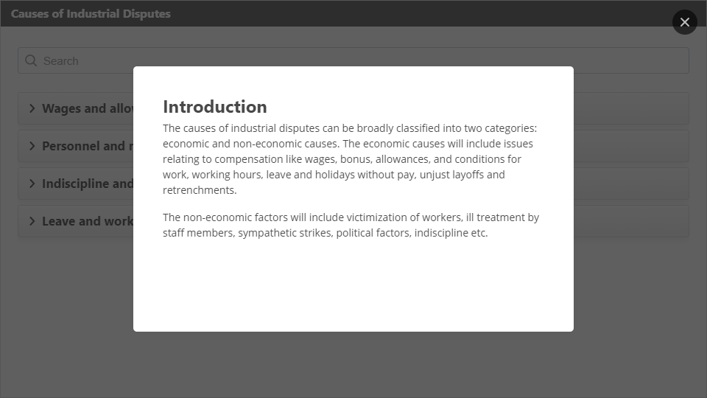
Interaction
Click the Interaction button to edit this object

Slide 38
Miscellaneous:
The miscellaneous factors include
- Inter/Intra Union Rivalry
- Charter of Demands
- Work Load- Standing orders/rules/service conditions/safety measures
- Non-implementation of agreements and awards etc.

