Slide 1

Learner guide
Demonstrate an understanding of a selected business environment
UNIT STANDARD NUMBER:14344
LEVEL ON THE NQF: 2
CREDITS: 10

Slide 2

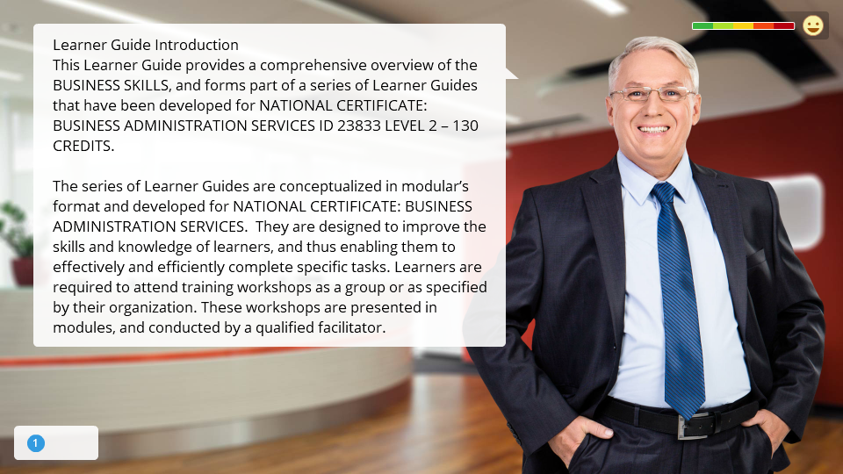
Simulation
Click the Simulation button to edit this object

Slide 3
Learning Outcomes
AT THE END OF THIS SKILLS THE CANDIDATE WILL BE CAPABLE OF:
Demonstrate an understanding of a selected business environment
Contribute to the health, safety and security of the workplace
Keep informed about current affairs related to one`s own industry
Investigate the structure of an organization as a workplace

Slide 4
SESSION 1
Explain the structure and roles of different types of organisations within their own industry in SA
Assessment Criteria
The various types of organisation are named and explained using the terminology accepted within their own industry. The roles of the different types of organisation are explained in the context of the business environment. Business activities common to all organisations within the sector are identified and listed from readily available information. Two examples of companies in each business sub-sector are identified from advertisements in the media. Four of the main players in the field are identified and the kind of products or services offered by each are listed and categorised according to purpose.

Slide 5
ESSENTIAL EMBEDDED KNOWLEDGE
Learners can explain the structure and roles of the different types of organisation in this sector in South Africa, including their main business activities, using the terminology accepted within this sector. They are able to name organisations operating within this environment.

Slide 6
What is an "Organization?
"A group of persons with a common objective" (Neoclassical)
"A structured process in which individuals interact for objectives" (Hicks, Management of Organizations, p.23)
"A structure of relationships, power, objectives, roles, activities, communications and other factors that exist when persons work together" (Classical amalgamism)
"A dynamic social system of cooperative interactions with the purpose of satisfying individual needs" (Chaster Barnard, 1938; = transition between neoclassical and modern; accommodating formal and informal aspects of organizations)
"A set of social relations deliberately created, with the explicit intention of continuously accomplishing some specific goals or purposes" (Stinchcombe, in J.March, ed., Handbook of Organizations, 1964, p.142.)
"A system of structural interpersonal relations ... (within which) ... individuals are differentiated in terms of authority, status, and role with the result that personal interaction is prescribed... Anticipated reactions tend to occur, while ambiguity and spontaneity are decreased" (R.V. Presthus)

Slide 7
"A system consisting generally of inputs, process, outputs, feedback, and environment" (Norbert Wiener's cybernetic interpretation of organization)
"A set of interlocked activities under unified control" (Pfeffer & Salancik)
"Every organized human activity -- from the making of pots to the placing of a man on the moon -- gives rise to two fundamental and opposing requirements: The division of labor into various tasks to be performed, and the coordination of these tasks to accomplish the activity" (Mintzberg, 1983)
"The most effective organizations achieve a degree of differentiation and integration in organizational boundary-spanning functions which is compatible with environmental demands" (Lawrence & Lorsch, 1967)
"Formal organization: "The goals to be achieved, the rules the members of the organization are expected to follow, and the status structure that defines the relations between them have not been spontaneously emerged in the course of social interaction but have been consciously designed a priori to anticipate and guide interaction and activities" (Blau & Scott, Formal Organization, 1962, p.5)

Slide 8
The Standard Industrial Classification
The Standard Industrial Classification Divides Businesses and Organisations into the following Industries:
Agriculture
Mining and Quarrying
Manufacturing
Electricity, Gas and Water
Construction
Retail and Motor Trade and Repair Services
Wholesale Trade, Commercial Agents and Allied Services
Catering, Accommodation and other Trade
Transport, Storage and Communications

Slide 9
Sectors Of Business
When we have determined what type of business we are dealing with, we can classify them further according to their activities:
Primary sector: This sector is involved in exploiting natural resources in their raw and unprocessed form. This would be the dairy farmer, who is classified as agriculture according to the type of organisation.
Secondary sector: This sector is involved in processing and converting these exploited natural resources into a final product. This would be Dairy Belle, who buys the milk from the farmer, processes and packages it and delivers it to the retailer. We classify them as wholesalers.
Tertiary sector: This sector is responsible for conveying the final products from the manufacturer to the consumer. This would be the supermarket, the spaza shop, wherever you buy your milk. We classify them as retail trade.

Slide 10
Definitions
A couple of explanations to help you distinguish between types of businesses:
Services
A service business is any business which sells a service to customers. These types of businesses usually generate income in the form of a percentage or a fee. Examples of service providers:
Taxis | Buses
Trains | Training companies
Hair dressers | Banks
Bookkeepers and auditors | Attorneys

Slide 11
Manufacturers
A manufacturer processes raw material into finished products, ready for resale or distribution to wholesalers or direct to retailers. Examples include:
Furniture manufacturers
Clothing manufacturers
Car manufacturers
Wholesalers:
Wholesalers are the intermediary companies that act between manufacturers and retailers or industrial users by assembling, storing and distributing products. Examples are Makro, Trade Centre. When you buy from a wholesaler, you have to buy in bulk. You are not usually able to buy only one or two items of a product.

Slide 12
Retailers:
Retailers usually break-bulk products into saleable portions. Examples are:
supermarkets,
butchers,
cell phone shops,
spazas,
convenience stores
Services
A service business is any business which sells a service to customers. These types of businesses usually generate income in the form of a percentage or a fee.

Slide 13

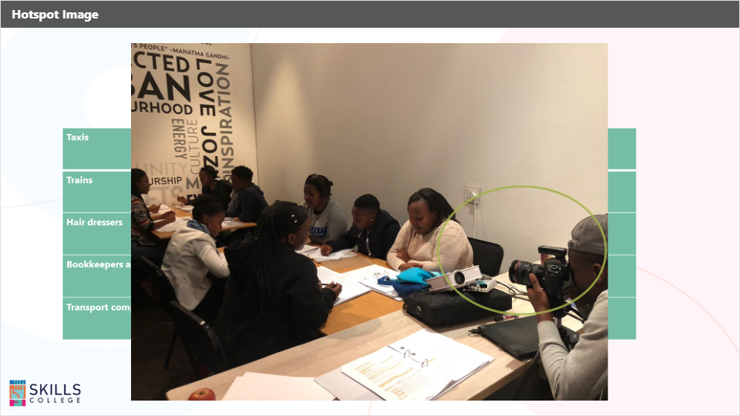
Interaction
Click the Interaction button to edit this object
Taxis | Buses
Trains | Training companies
Hair dressers | Banks
Bookkeepers and auditors | Attorneys
Transport companies | Professional bodies
Taxis | Buses
Trains | Training companies
Hair dressers | Banks
Bookkeepers and auditors | Attorneys
Transport companies | Professional bodies

Slide 14
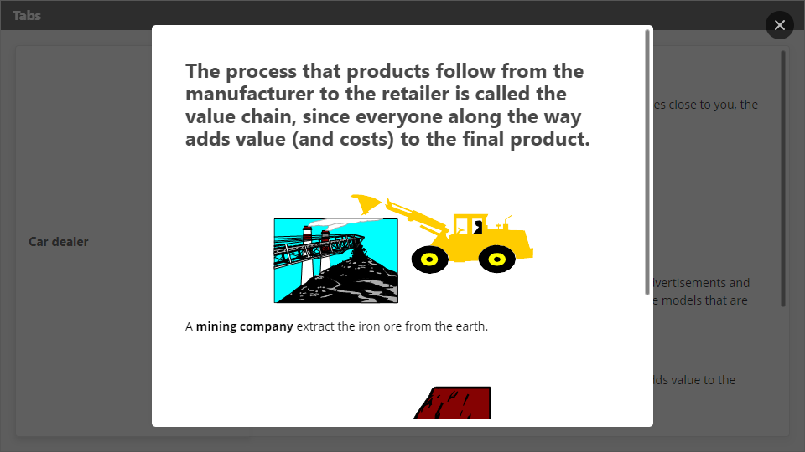
Interaction
Click the Interaction button to edit this object

Slide 15
Business Activities In The Business Environment
The business activities of any organisation are the things they do in order to generate money and make a profit. It can also be said that the business activities of a business or an organisation is the reason they exist.
The business activities of Arcelor Mittal are extracting the iron ore from the earth producing iron and steel and then selling these as raw products.
The business activity of BMW is to manufacture cars. The cars are then delivered to their agents, who are geographically closer to the consumer.
Pick n Pay’s business activities is buying products wholesale or directly from the manufacturer and selling them to the consumer.
From the above examples we can see that there is an entire chain of business activities from ISCOR to where the car is delivered to the car dealer, who sells the car to the consumer.

Slide 16
Let us look at milk for the next example
The dairy farmer produces the milk, is classified under agriculture and forms part of the primary sector of business. The business activity of the dairy farmer is producing milk. The farmer then takes the milk to Dairy Belle.
Dairy Farmer
Dairy Belle
Dairy Belle buys the milk from the farmer, checks it for content and cleanliness, checks for bacteria and so on in the milk, packages the milk and then sends it to Pick N Pay and other retailers. The business activity of Dairy Belle is the processing and packaging of milk and other related products. They are classified as wholesalers and form part of the secondary sector of business.

Slide 17
Pick N Pay
Consumer
You, the consumer, buy the milk at a location close to you. Your business activity is your job, where you earn the money to buy the milk.
Of course, there is one more role player in this chain of business that we have not mentioned at all: the transport company who transports the milk from the farmer (where the farmer does not do his own transport) to the wholesaler, and from the wholesaler to the retailer.
In this chain of business activities, everyone, except the transport company delivers products. The transport company, of course, provides a service.
The whole purpose of this chain of business activities is, of course, to bring the milk from the farm to you, the consumer, at a location close to you and in a packaging that is convenient to you.
Pick N Pay purchases the milk from Dairy Belle and pack it in the fridges for the consumer to buy. They are classified as retailers and form part of the tertiary sector of business. The business activity of Pick N Pay is the buying of products wholesale and selling them to the consumer at retail prices.

Slide 18
What is a value chain?
A value chain is a chain of activities for a firm operating in a specific industry. Products pass through all activities of the chain in order, and at each activity the product gains some value. The chain of activities gives the products more added value than the sum of the independent activities' values.
An industry value chain is a physical representation of the various processes that are involved in producing goods (and services), starting with raw materials and ending with the delivered product (also known as the supply chain).
The activities of a business could be grouped under two headings:
(1) Primary Activities - those that are directly concerned with creating and delivering a product (e.g. component assembly); and
(2) Support Activities, which whilst they are not directly involved in production, may increase effectiveness or efficiency (e.g.human resource

Slide 19
Primary value chain activities include:
Primary Activity | Description
Inbound logistics | All those activities concerned with receiving and storing externally sourced materials
Operations | The manufacture of products and services - the way in which resource inputs (e.g. materials) are converted to outputs (e.g. products)
Outbound logistics | All those activities associated with getting finished goods and services to buyers
Marketing and sales | Essentially an information activity - informing buyers and consumers about products and services (benefits, use, price etc.)
Service | All those activities associated with maintaining product performance after the product has been sold

Slide 20
Support activities include:
Secondary Activity | Description
Procurement | This concerns how resources are acquired for a business (e.g. sourcing and negotiating with materials suppliers)
Human Resource Management | Those activities concerned with recruiting, developing, motivating and rewarding the workforce of a business
Technology Development | Activities concerned with managing information processing and the development and protection of "knowledge" in a business
Infrastructure | Concerned with a wide range of support systems and functions such as finance, planning, quality control and general senior management

Slide 21
Identifying Business Activities
Core business
The core business of a company is the business that it is primarily in. The core business activities are the activities that are most essential and important and that are of course linked to the core business.
If you are mining, the core business is extracting the iron ore or gold. The core business activities are then the activities to do with extracting iron ore or gold from the earth: blasting, digging, etc.
If you are a farmer, your core business is farming with chickens or animals or crops. The core business activities will be:
Breeding and feeding chickens or beef, maintaining their health, etc. If you are farming with crops, the business activities will be preparing the ground, planting, watering, harvesting, etc.

Slide 22

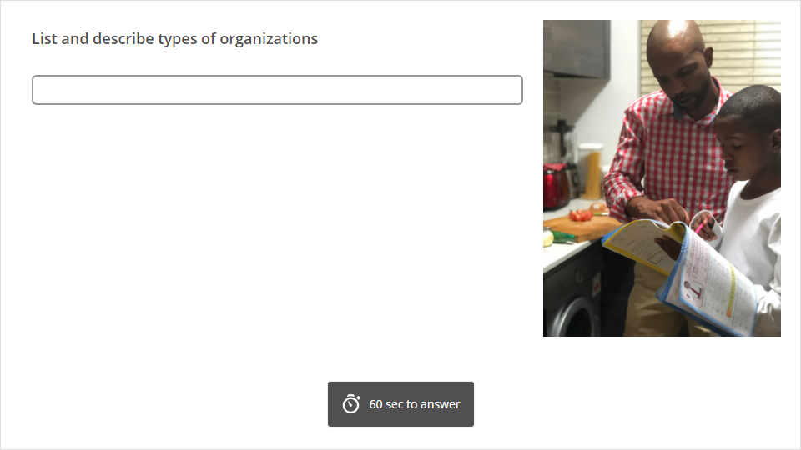
Quiz
Click the Quiz button to edit this object

Slide 23
SESSION 2
Demonstrate an understanding of the concept of a market as applied to a selected business sector
The principles of trade that define markets are identified at a basic level of understanding.
The basic principles for the marketing of products are differentiated from the basic principles for the marketing of services.
The role of a selected business sector in the national economy is explained in the context of the business environment.
The value chain describing the way business is conducted in the sector is explained, illustrating with examples.

Slide 24
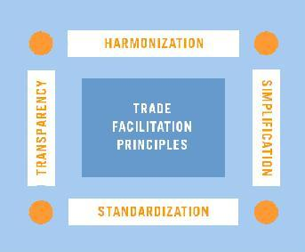
Basic Principles of Trade facilitation
In order to provide a worldwide accepted, consistent, transparent and predictable environment for international trade transactions, it is necessary to have much greater:
Harmonization of applicable laws and regulations
Simplification of administrative and commercial formalities, procedures and documents
Standardization and integration of information and requirements, and the use of technologies so as to exchange this information efficiently
Transparency, which implies making information on border requirements and procedures available and easily accessible to all interested parties

Slide 25
Trade facilitation takes place at national, regional and international levels. At the national level, it focuses on harmonizing and simplifying the trade-related structures and procedures within a country. As goods across international borders they move from one legal and administrative jurisdiction to another, it is therefore essential to standardize norms internationally. Here lies the important role of the United Nations, the World Trade Organization, other intergovernmental bodies and the international business organizations that develop the tools for facilitating trade.

Slide 26
Basic Principles of Marketing
There are a few things you must know when planning your marketing campaign. These factors are the "Principles of Marketing". Learning how to market correctly is the biggest task when starting a new business or selling a new product. Without proper marketing, your endeavors will more than likely not succeed. The following are some basic principles of marketing.
[Product] When marketing, you must first create a product or service that is clear and easy to comprehend so the potential buyers will have no problems in understanding what your company is offering. This is by far the most important role in marketing. If you are offering a product or service to impending clients and the client cannot fully understand what your product or service is and does, they will pick up and move on. A few of the things you can include in your campaign to make sure the public will understand your product and service is include a warranty, customer service, instructions, company name, visual examples of how your product or service works.

Slide 27
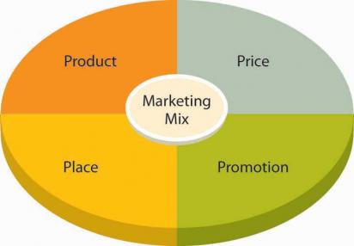
[Price] The next issue to work with when working on your marketing campaign is to create a price that is reasonable and competitive with your other companies in your market. You should do some research on these companies and find out the average prices of your type of product or service and in turn create a price that is lower than the average if it is possible in your budget and profit margin. The public will notice a product or service substantially quicker if the price is in their budget and with the growing economy, the public will appreciate a low-cost product or service.

Slide 28
[Place] When marketing your product or service you must also choose a location that will best suit your company in reaching your prospective market. This is a task that few people will really spend the time on but it plays a major role in how well your business does. Think of it like this, would you promote your children's toy inside of a bar? You must choose a location to promote that will reach your future client base. This holds true for new products more than existing companies and products because if people do not know your product exists then how will they know they need it and buy it.
[Promotion] You must always remember that communication with your consumer base is by far the most important aspect in marketing a new product or service. If you can make your client feel safe and feel as though they are making the right choice in choosing your product, you are one step ahead of your competition. Safety with their money is a large part in the decision the potential clients make when choosing a product or service that they are in need of, and if you can make sure they feel safe, you will be 1 huge step closer in closing the deal. Safety is key, and will always be the most important aspect in marketing a new product or service.

Slide 29
Value Chain Analysis
Introduction
Value Chain Analysis describes the activities that take place in a business and relates them to an analysis of the competitive strength of the business. Influential work by Michael Porter suggested that the activities of a business could be grouped under two headings:
(1) Primary Activities - those that are directly concerned with creating and delivering a product (e.g. component assembly); and
(2) Support Activities, which whilst they are not directly involved in production, may increase effectiveness or efficiency (e.g. human resource management). It is rare for a business to undertake all primary and support activities.
Value Chain Analysis is one way of identifying which activities are best undertaken by a business and which are best provided by others ("out sourced").

Slide 30
Linking Value Chain Analysis to Competitive Advantage
What activities a business undertakes is directly linked to achieving competitive advantage. For example, a business which wishes to outperform its competitors through differentiating itself through higher quality will have to perform its value chain activities better than the opposition. By contrast, a strategy based on seeking cost leadership will require a reduction in the costs associated with the value chain activities, or a reduction in the total amount of resources used.

Slide 31
Primary Activities
Primary value chain activities include:
Primary Activity | Description
Inbound logistics | All those activities concerned with receiving and storing externally sourced materials
Operations | The manufacture of products and services - the way in which resource inputs (e.g. materials) are converted to outputs (e.g. products)
Outbound logistics | All those activities associated with getting finished goods and services to buyers
Marketing and sales | Essentially an information activity - informing buyers and consumers about products and services (benefits, use, price etc.)
Service | All those activities associated with maintaining product performance after the product has been sold

Slide 32
Support Activities
Support activities include:
Secondary Activity | Description
Procurement | This concerns how resources are acquired for a business (e.g. sourcing and negotiating with materials suppliers)
Human Resource Management | Those activities concerned with recruiting, developing, motivating and rewarding the workforce of a business
Technology Development | Activities concerned with managing information processing and the development and protection of "knowledge" in a business
Infrastructure | Concerned with a wide range of support systems and functions such as finance, planning, quality control and general senior management

Slide 33
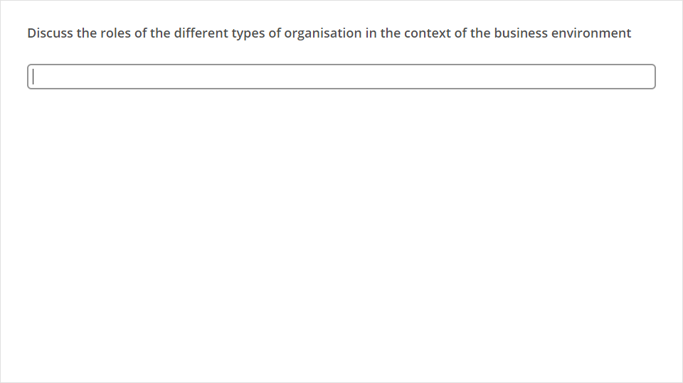
Quiz
Click the Quiz button to edit this object

Slide 34
SESSION 3.
Identify and describe the role of professional bodies in a selected business sector
The reasons for the existence of professional bodies, associations and regulatory authorities within or affecting this sector are explained in the context of the roles that they play.
Three professional bodies, associations or regulatory authorities are identified for each of the sub-sectors.
The benefits of belonging to a selected professional body, association or regulatory authority within the sector are outlined from the perspective of both the organization and the individual.
Information about two of the professional bodies, associations or regulatory authorities is accessed from its website or an industry publication.

Slide 35
The Need for Professional Bodies and Regulatory Authorities
It establishes a forum where people who work in the same industry can get together and exchange ideas, problems and success stories as a form of support to each other. Many of these bodies hold monthly meetings where members get together to discuss issues relating to their particular industry.
Through newsletters circulate information about the industry to its members
Regulate the conduct of its members, in order to ensure that all member deliver a high standard of conduct and customer service at all times. In many instances, these bodies have enough authority to ban dishonest traders or people who conduct business in an unprofessional manner. Doctors and dentists are a good example, as are lawyers. When a lawyer acts unprofessionally, he can be disbarred, meaning he can be forbidden to practice his occupation anywhere in South Africa.
To undertake all such activities as are likely to be of benefit to the businesses and organisations in the related sector and in the interest of its members. These bodies undertake to keep up-to-date with national and international developments, as well as legal matters concerning their industry, and to keep their members up to date on these matters.

Slide 36
Benefits of Belonging to A Professional Body
You can display your membership status to put your customers’ minds at ease, you can even use it as a selling point.
These organisations hold regular meetings where you can meet other people from your industry.
Most professional bodies also have regular workshops that are targeted to meet the needs of its members.
At times a big corporate client will contact the professional body in order to find a member of the organisation to do business with. This happens a lot in the photographic industry, where a corporate client such as BMW will contact the regulatory body to find a professional photographer for a specific photographic shoot.
The association or professional body is ensures that a professional image of their members is carried across to the business world.

Slide 37

Which Professional Bodies, Associations or Regulatory Authorities Are Available?
There are many such professional bodies and they cover the entire spectrum of business sectors and industries.
Some examples are:
Institute for Public Finance and Accounting.
Law Society of SA
Pretoria Chamber of Business
Johannesburg Chamber of Business
Private Security Industry Regulatory Authority
SA Medical and Dental Council
SA Veterinary Association
Institution of Marketing Management
SA Tourism Board
Institute of Training Management

Slide 38

These institutions usually have more than one kind of membership, depending on your level of qualification and years of experience. Membership is usually for a one-year period and membership fees are payable as determined by the institution.
In some industries, membership of the institution is compulsory before you will be allowed to do any kind of business.
We will take a look at professional bodies for Public Relations as an example
Public Relations Bodies (PRISA and PRASA)
The International Public Relations Association was founded in 1955 with the object of raising international public relations standards, and now has members in most countries around the world.
The Public Relations Institute of South Africa was founded in l959. Today, it has 1500+ members and branches in Johannesburg, Pretoria, Cape Town, Durban, Port Elizabeth and Bloemfontein. It has performed the spadework of establishing public relations and putting together the requisite organization and knowledge. Through its insistence on genuine qualifications for the profession, certified by its examinations, it has gone a long way towards eliminating the fly‑by‑night operator and confirming the reputation of the Public Relations practitioner.

Slide 39
There are six different membership categories:
Fellows
These are PRISA Members on whom the Council has conferred Fellowships in recognition of long and distinguished service to the Institute or the profession. Fellows are entitled to use the letters FPRISA.
Full Members
These are persons who devote all or a substantial amount of their time to practicing Public Relations in a senior capacity, and who have at least five years comprehensive experience in public relations practice or have attained a BA Communications degree with public relations as the main subject, plus at least three years' comprehensive experience in public relations practice, or have passed the Final Examination of the Institute and have at least three years comprehensive experience in public relations practice. Such persons must also satisfy the Council that they are able to practice public relations work on a professional and ethical level. Members are entitled to use the letters MPRISA.

Slide 40
Associates
These are persons with at least three years’ experience in public relations practice, or who have passed the Final Examination of PRISA and have at least one year's experience in public relations practice, or can satisfy the Council that they possess a thorough understanding of the principles of public relations, and are qualified to undertake its practice by reason of previous experience, general qualifications and the position they occupy. Associate Members shall be entitled to use the unabbreviated description 'Associate of the Public Relations Institute of South Africa'.
Fellows, Members and Associates have full voting rights in the affairs of PRISA.
Affiliates
These are persons not eligible for Associate Membership, but associated with the practice of public relations, or who have passed the Intermediate Examination of the Institute. Affiliates are not entitled to the use of any letters or description and cannot vote at a general meeting of the Institute.

Slide 41
Student Members
(a) Are those following a recognised bachelor degree course with Communication Science as a major and public relations as a specialisation upon submission of written proof of having registered to study the public relations component.
b) Students of the National Diploma in Public Relations upon submission of written proof of having registered for the second year of study.
Honorary Membership
Honorary Membership can be conferred by the Council in exceptional circumstances on persons, from within or without the Institute, in recognition of outstanding services to the Institute or to the public relations profession.

Slide 42
OBJECTIVES OF PRISA
The PRISA Constitution lists the following objectives:
(a) To bring together those engaged in public relations work, for the interchange of views and experience and for mutual consultation and advantage.
(b) To establish and maintain the full professional status and dignity of public relations work amongst members, practitioners, employers and the general public.
(c) To foster and encourage the close observance of the highest professional conduct by its members, and to prescribe such conduct.
(d) To give a united voice to the practice of public relations and to enhance its influence.
(e) To undertake all such activities as are likely to be of benefit to the practice of public relations and in the interest of its members.

Slide 43
CODE OF CONDUCT OF PRISA
The Public Relations Institute of South Africa abides by the Code of Conduct of the International Public Relations Association.
This is quoted below:
1. Conduct Towards Clients and Employers
(a) A member has a general duty of fair dealing towards his clients or employers, past and present.
(b) A member shall not represent conflicting or competing interests without the express consent of those concerned,
(c) A member shall safeguard the confidences of both present and former clients or employers.
(d) A member shall not employ methods tending to be derogatory to another member's client or employer.

Slide 44
2. Conduct Towards the Public and the Media
(a) A member shall conduct his professional activities in accordance with the public interest, and with full respect for the dignity of the individual.
(b) A member shall not engage in any practice which tends to corrupt the integrity of channels of public communication.
(c) A member shall not intentionally disseminate false or misleading information.
(d) A member shall at all times seek to give a balanced and faithful re presentation of the organisation which he serves.
(e) A member shall not create any organisation to serve some announced cause but actually to serve an undisclosed special or private interest of a member or his client or his employer, nor shall he make use of it or any such existing organisation.

Slide 45
3. Conduct Towards Colleagues
(a) A member shall not intentionally injure the professional reputation or practice of another member. However, if a member has evidence that another member has been guilty of unethical, illegal or unfair practices, including practices in violation of this Code, he should present the information to the council of his national Public Relations Institute.
(b) A member shall not seek to supplant another member with his employer or client.
(c) A member shall cooperate with fellow members in upholding and enforcing this Code
Representative body Freight Forwarders
The representative body of the freight forwarding industry is called South African Association of Freight Forwarders (SAAFF). The following information was taken from their website at
www.saaff.org.za

Slide 46
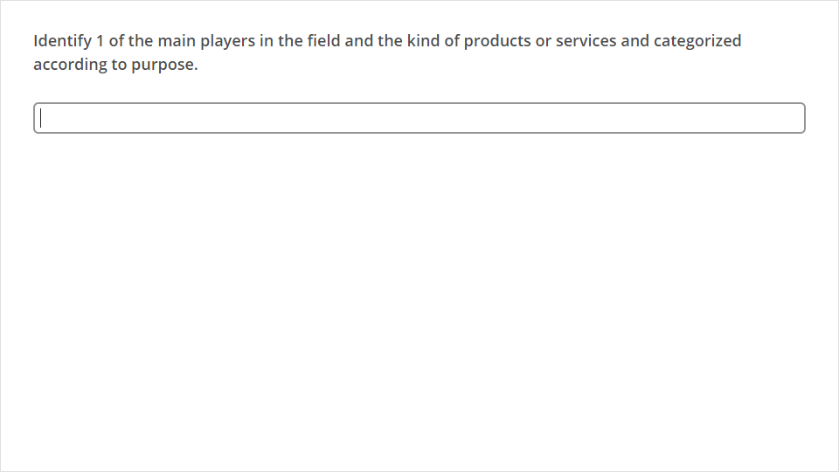
Quiz
Click the Quiz button to edit this object

Slide 47
SESSION 4.
Discuss the market position of a selected organization in the relevant sub-sector
A list of 10 of the products and / or services marketed by a selected organization is tabulated and compared with equivalent products and / or services of competitor organizations.
A description of the organisation's current competitive position is given, based on available audited data.
The strengths and weaknesses of the organization are compared with those of its two major competitors.
The opportunities and threats facing the organization are explained with reference to the external environment.

Slide 48
Introduction
In marketing, positioning has come to mean the process by which marketers try to create an image or identity in the minds of their target market for its product brand, or organisation, and what adds value to the customers.
Market positioning is the manipulation of a brand or family of brands to create a positive perception in the eyes of the public. If a product is well positioned, it will have strong sales, and it may become the go-to brand for people who need that particular product. Poor positioning, on the other hand, can lead to bad sales and a dubious reputation. A number of things are involved in market positioning, with entire firms specializing in this activity and working with clients to position their products effectively.
When a product is released, the company needs to think beyond what the product is for when it comes to positioning. It also thinks about the kinds of people it wants to buy the product. For example, a luxury car manufacturer might be less interested in promoting reliability, and more interested in promoting drivability, appealing to people who are looking for high-end cars which are enjoyable and exciting to drive. Conversely, a company making mouthwash might want to go for the bottom end of the market with an appealing low price, accompanied by claims asking consumers to “compare to the leading brand” so that they can see that the product contains the same active ingredients as a famous brand, at a much lower price.

Slide 49
Competitive position
The competitive position of a business is the position that a firm occupies in a market, or is trying to occupy, relative to its competition.
Competitive Advantage'
An advantage that a firm ha sover its competitors, allowing it to generate greater sales or margins and/or retain more customers than its competition.
Competitive advantages give a company an edge over its rivals and an ability to generate greater value for the firm and its shareholders.

Slide 50
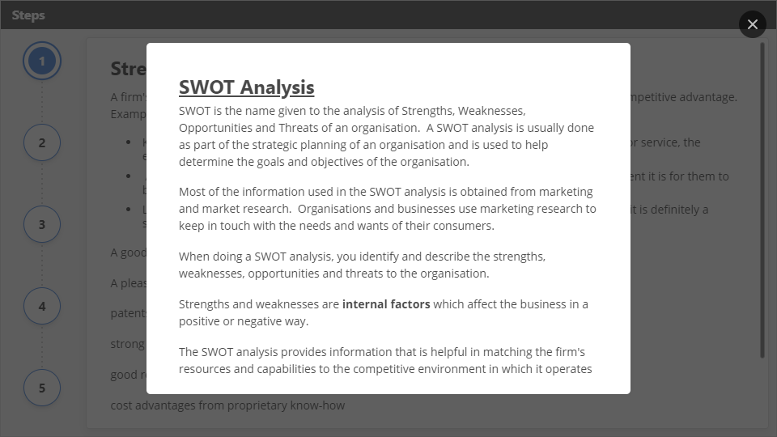
Interaction
Click the Interaction button to edit this object

Slide 51
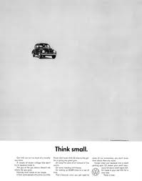
Why are these 10 marketing campaigns the best of all time?
Because of the impact they had on the growth of the brand, and because they manage to hit on some universal truth that allows us to remember these campaigns years after they first began. In fact, many of us (myself included) might not have even been alive when these campaigns first aired! So here they are, in no particular order (rest assured, you can nominate your favorites in the comments) -- the best marketing and advertising campaigns of all time, and the lessons we can learn from them!
Volkswagen: Think Small

Slide 52
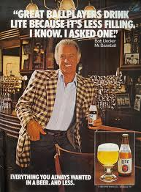
Many marketing and advertising professionals like to call this campaign the gold standard. Created by a legendary advertising group at Doyle Dane & Bernbach in 1960, the campaign set out to answer one question: How do you change peoples' perceptions about not only a product, but about an entire group of people? Americans always had a propensity to buy big American cars, but even 15 years after WWII ended, Americans really didn’t buy small German cars. So what did this Volkswagen advertisement do? It played right into the audience’s expectations. You think I’m small? Yeah, I am. They never tried to be something they were not -- and that's the most important lesson we can learn from this campaign. Don’t try to sell your company, product, or service as something it’s not. Consumers appreciate honesty just as much as they appreciate hot girls in beer commercials.
Miller Lite: Great Taste, Less Filling

Slide 53
Market Positioning
Positioning refers to how you communicate the essential benefits of your small business to potential customers. Where you sell your product, how you make it, where you make it and your price all convey subtle messages to the marketplace, even without your using any overt advertising, public relations or promotions.
Positioning Strategy
Positioning strategies can be conceived and developed in a variety of ways. It can be derived from the object attributes, competition, application, the types of consumers involved, or the characteristics of the product class. All these attributes represent a different approach in developing positioning strategies, even though all of them have the common objective of projecting a favorable image in the minds of the consumers or audience.

Slide 54
A good positioning strategy is influenced by:
Market profile: Size, competitors, stage of growth
Customer segments: Groups of prospects with similar wants & needs
Competitive analysis: Strengths, weaknesses, opportunities and threats in the landscape
Method for delivering value: How you deliver value to your market at the highest level
Evaluate your competition
List your competitors. Include any that can solve your customers’ problems, even if the competitors’ solutions are much different from yours – they’re still your competition.
Rate yourself and your direct competitors based on operational efficiency (price), product leadership and customer intimacy. It’s easy to think you’re the best, so be as impartial as you can be.

Slide 55
Stake a position
Identify areas where your competition is vulnerable.
Determine whether you can focus on those vulnerable areas – they’re major opportunities.
Make a decision on how to position your offering or company.
Select the mindshare you want to own, and record your strategy
Review the components of your market and evaluate what you want to be known for in the future. Condense all your research and analysis into the “one thing” that you want to be known for, and design your long-term strategy to achieve it.
Specific Demographic
If you try to be everything to everyone, you may not appeal to any group. For example, Secret deodorant markets itself as made specifically for women. This loses it sales among men; but it may increase its overall market share by getting more women to buy this deodorant than other brands, since they believe it is unique. Makers of athletic equipment offer different models of the same equipment for beginners and advanced players, making those products more attractive to specific consumers.

Slide 56
Low-Price Strategy
Some companies position themselves as affordable options for consumers by selling low-priced goods. This may require a corresponding decrease in quality, such as a restaurant spending less on interior design or a car manufacturer offering fewer standard options, such as leather seats. An example of this low-price strategy is the 99-cent menus offered by many fast-food chains. Consumers know they can get a sandwich, side and drink for less than R50-00. This strategy works only if your potential customer is looking for affordability.
High-Price Strategy
Some companies price their products or services higher than their competition to create a perceived value. Consumers wonder why a particular company is able to sell its product for more or why their fellow consumers are willing to pay more for the product. In the end, they may believe that the higher-priced product or service is worth more. An example of this strategy is a personal trainer who charges R10 per hour more than the other trainers in his town.

Slide 57
Distribution
Where you sell your product says much about its quality. Tennis and golf equipment manufacturers position certain models in their line as higher quality by selling them only in pro shops or specialty stores. Because these rackets and clubs are not available at Walmart or Target, the public may believe these are the top-of-the-line models and desire them more.
Affinity
If you have a customer base with a common, personal denominator, you can position your company to play on their loyalty to their group. Examples of this type of positioning include marketers who advertise their products as made locally or in the United States; Christian-owned businesses; alignment with a charity; or sponsorship of a school sports program.

Slide 58
Biggest challenges / threats to an organization’s future success.

Slide 59
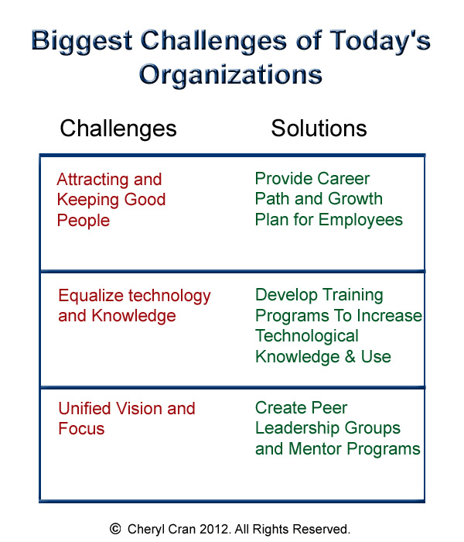

Slide 60
The challenges faced by today's organizations:
Organizations are facing different challenges in today's environment like:
Technology: Only 20 years ago, few workers used fax machines or e-mail, and computers occupied entire rooms, not desktops. Advances in information and communication technology have permanently altered the workplace by changing the way information is created, stored, used, and shared.
Diverse Workforce: A diverse workforce refers to two or more groups, each of whose members are identifiable and distinguishable based on demographic or other characteristics like gender, age group, education etc. Several barriers in dealing with diversity include stereotyping, prejudice, ethnocentrism, discrimination, tokenism, and gender-role stereotypes.
Multiple Stakeholders: Stakeholders are those who have interests in the company. Multiple stakeholders for an organization include the customers, suppliers, consumers, investors, lenders, etc.
Responsiveness: A corporation has to be responsive to the challenges and threats that it faces from within the internal or external environment. It requires quick responsiveness to meet the challenges and opportunities arising out of these changes.

Slide 61
What is Competitive Advantage?
Specifically, it is your company's unique skills and resources working to implement strategies that competitors cannot implement as effectively. Understanding your competitive advantage is critical. It is the reason you are in business. It is what you do best that draws customers to buy your product/service instead of your competitor's. Extremely successful companies deliberately make choices to be unique and different in activities that they are really, really good at and they focus all of their energy in these areas.
Sustaining Your Advantage Over the Competition
Of course, once you have identified your competitive advantage(s), you're not done. It is not enough just to have an advantage over your competitors. For your business to be great, it needs to weather competitive and environmental storms. You have to be able to combat today's fierce market forces and uncertainty. In other words, your competitive advantage needs to be sustainable and able to endure the test of time for your company to be great. Why? Because most advantages can be duplicated within a period of time.

Slide 62
Analyzing Your Organization's Competitive Advantage
Assess the Market Place and Industry Direction
Identify drivers in the market place and the future direction of the organization's industry (e.g., free trade, de-regulation, technology and its impact on consumers and business, merging of industries offering distinct but related products and services, such as telephone, cable television and computer companies). Identify issues affecting the industry (e.g., economics, regulatory or political issues).
Assess Products and Services
Identify the strengths and weaknesses with the organization's products and services. This information can be gathered by reviewing the organization's Strategic Business Plan and the customer, supplier and intermediary surveys and/or interview results.

Slide 63
Assess Competitors and Other Types of Industries
Compare the organization's performance with that of its competitors. Benchmarking can be used to compare the organization's performance with the industry's best or with the "best-of-breed" in other industries. Benchmarking can be expensive and can put artificial limits on the degree of innovation sought by the organization.
Industry Analysis
Michael Porter's Industry Analysis technique can be used to analyze an organization's competitive business position in its industry.

